Slide 1




How to Use PalmettoBUG to analyze great data in (Imaging) Mass Cytometry
By Ben Caiello at the MUSC Hollings Cancer Center Flow Cytometry and Cell Sorting Shared Resource Laboratory
Or, how to use (P)ALMETTO (A)cronym (L)onger (M)ore (E)ven (T)han (T)he (O)riginal (B)etter (U)ser (G)UI:
Or, how to use PALMETTO Acronym Longer More Even Than The Original Acronym Longer More Even Than The Original Better User (G)raphical (U)ser (I)nterface…
Or how to use PALMETTO Acronym Longer More Even Than The Original Acronym Longer More Even Than The Original Acronym Longer More Even Than The Original Better User Graphical User Interface …..
These are AI images generated at Openart.ai, so they are in the public domain
Notes:
4/3/2025

Slide 2
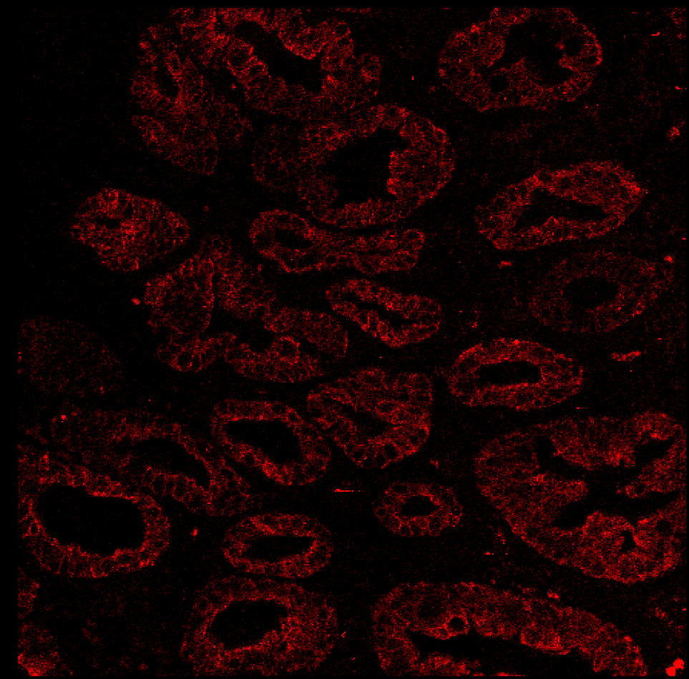
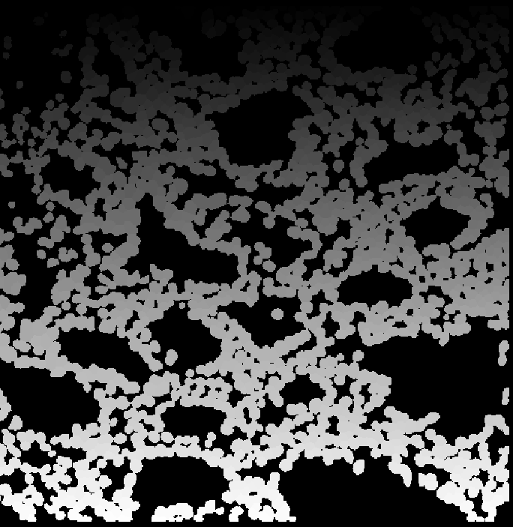
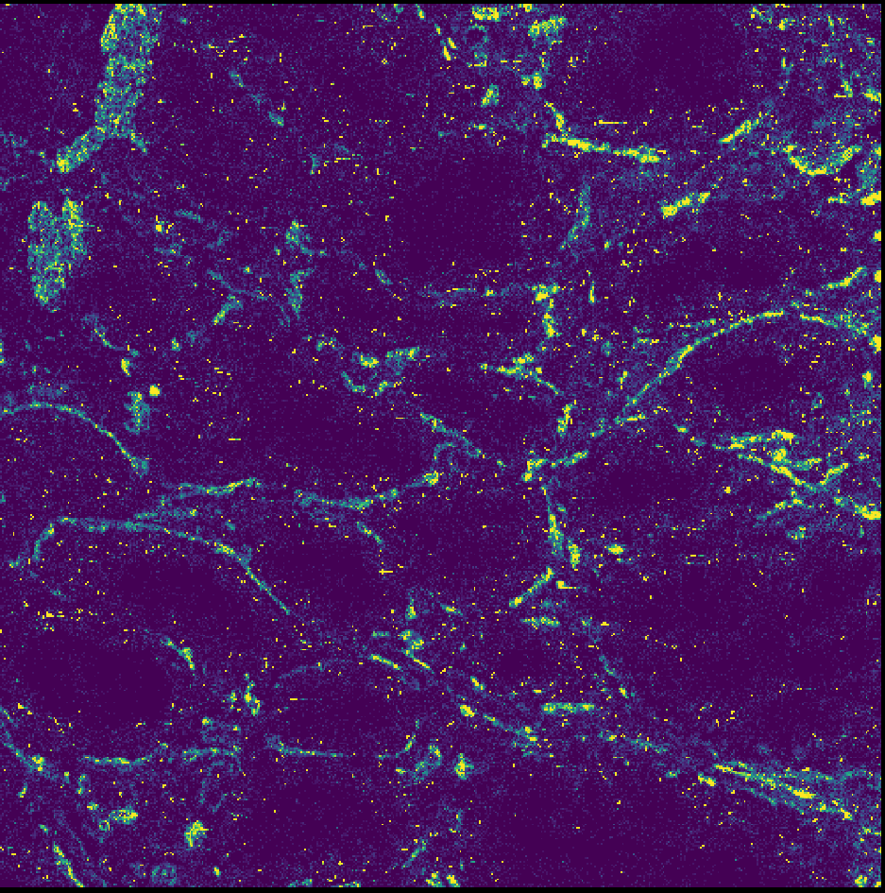
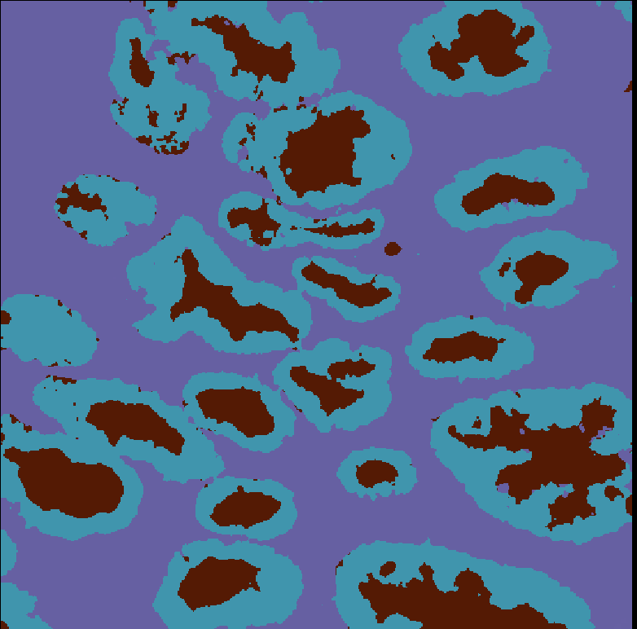
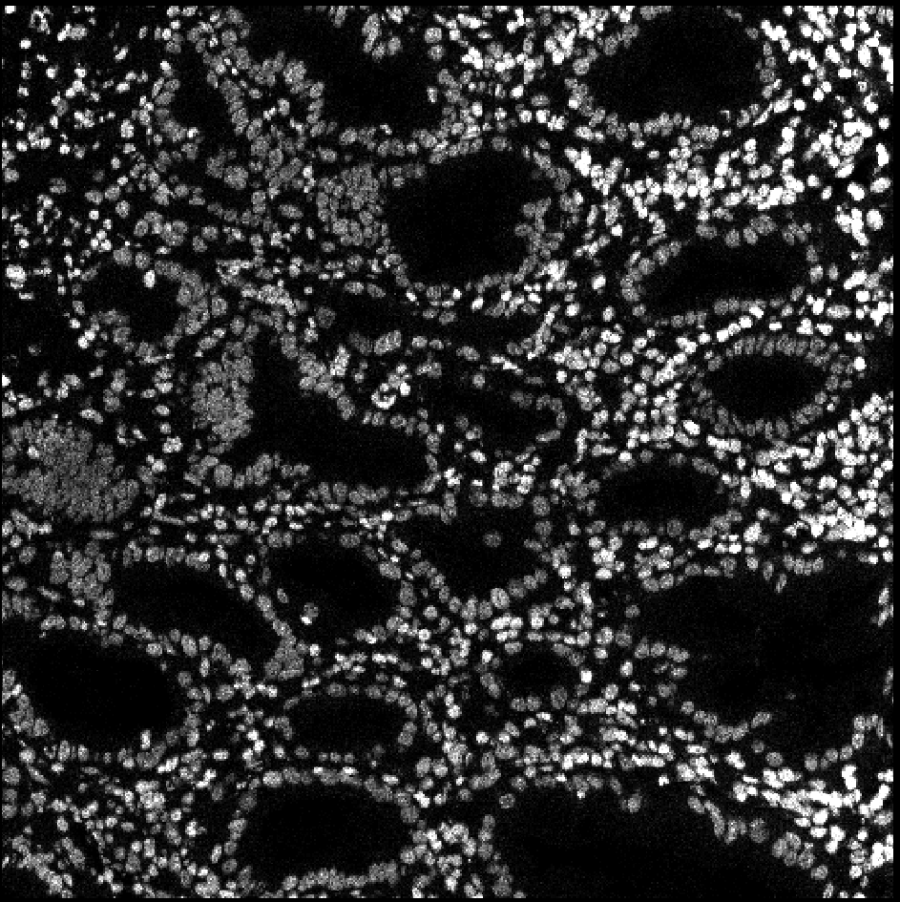
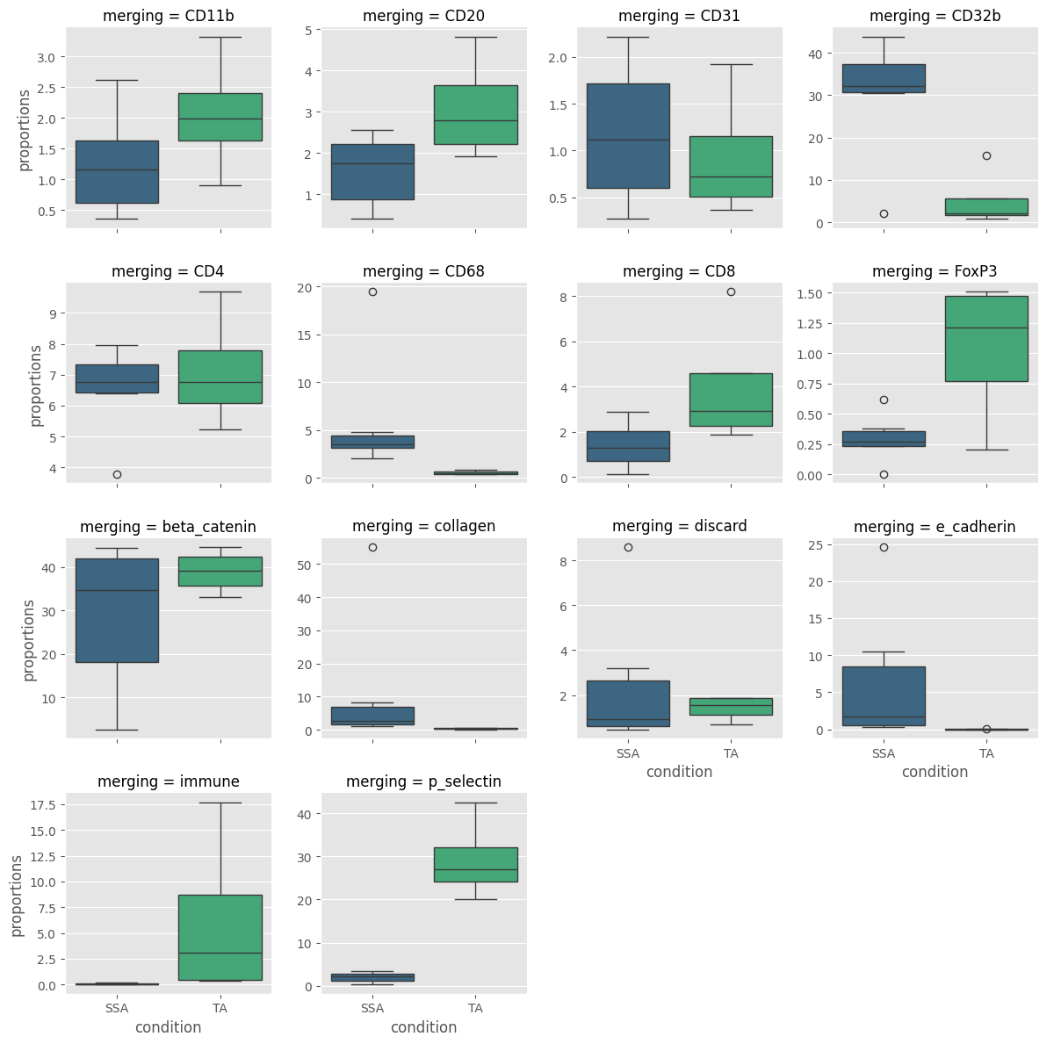
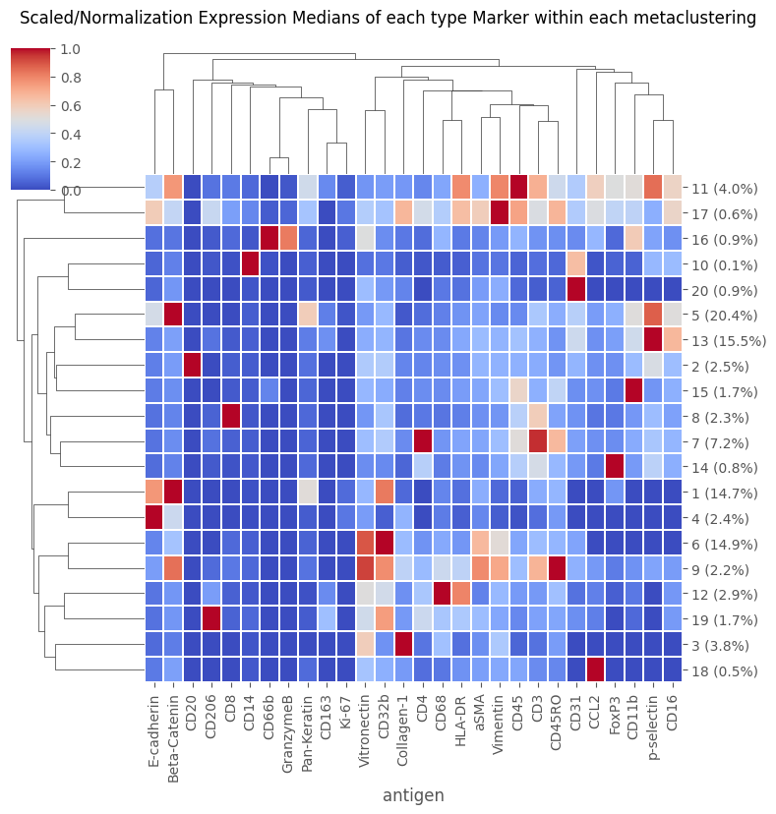
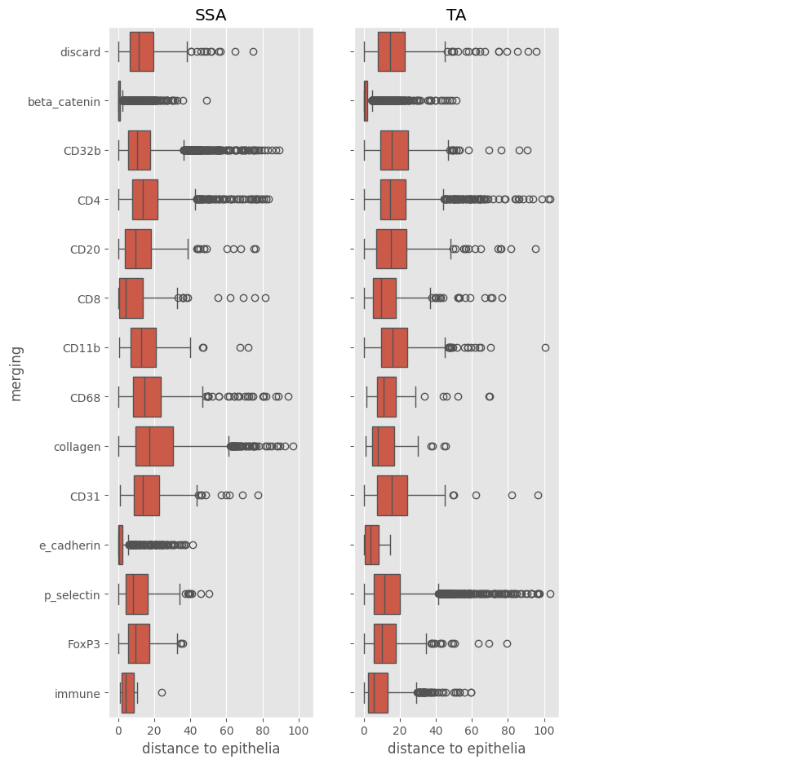
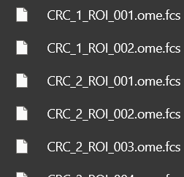
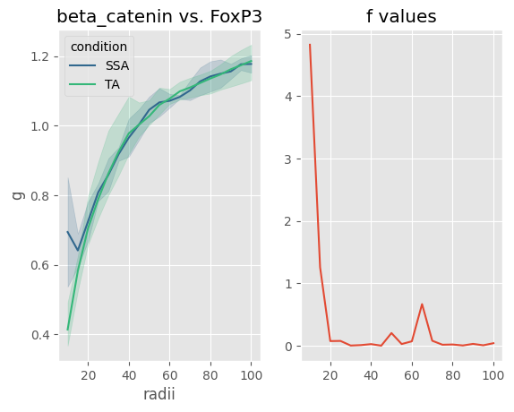
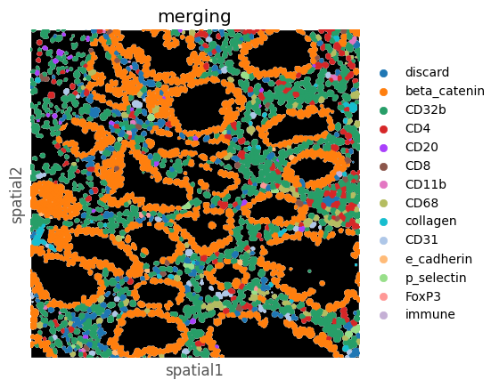
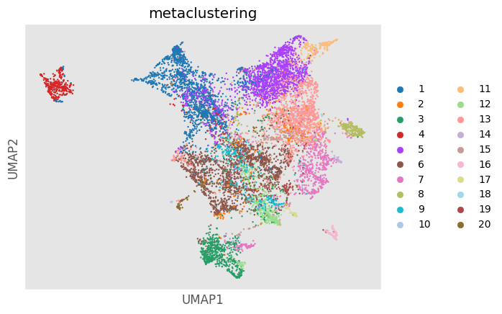
High Dimensional Images (.tiff file)
Segmentation (cells)
Overall Workflow:
MCD files
Hyperion / IMC
Pixel classification (optional)
MIBIScope or any high-dimensional tiff images
Cytometric Analysis
FCS files
Spatial Analysis
Mass Cytometry
(solution mode)
or any flow cytometry, such as high-dimensional spectral cytometry
Notes:
4/3/2025

Slide 3
Installation & Getting Started
1). Create a python environment for your PalmettoBUG installation (whether it’s conda, venv, etc.)
2). Inside your environment, run:
> pip install palmettobug
> pip install isosegdenoise[tensorflow]
(The [tensorflow] tag on the isosegdenoise installation is optional -- it controls what deep-learning backend is used for Mesmer / DeepCell segmentation)
3). Once both packages & all dependencies are downloaded & installed, in your environment
Issue the following command to launch the GUI:
>>> palmettobug
Alternatively, you can import palmettobug & call palmettobug.run_GUI() from inside python
Notes:
4/3/2025

Slide 4
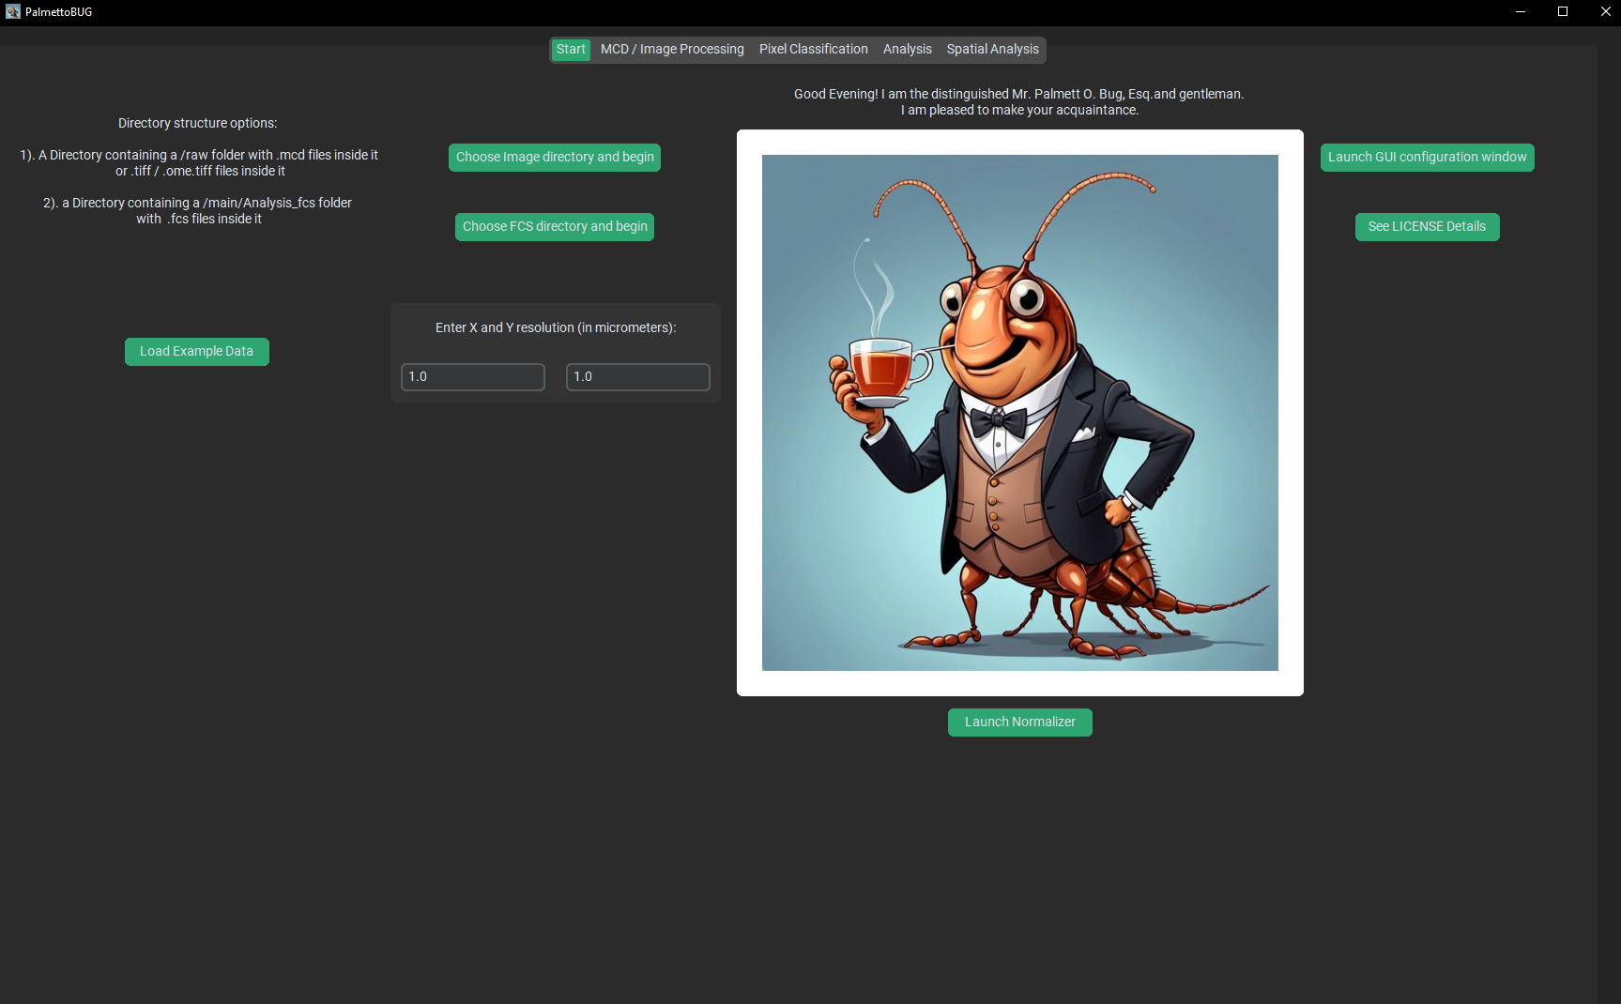
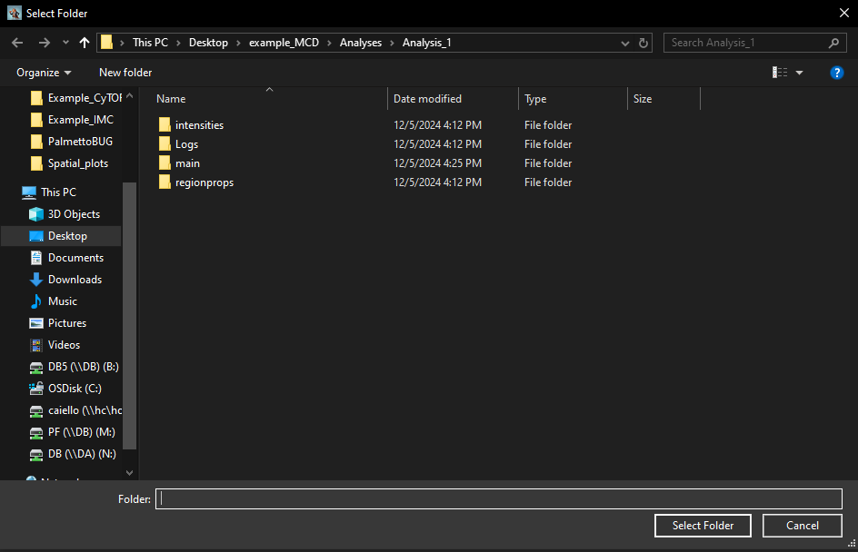
The Opening Screen!
The tabs of the program are accessible here
These 2 buttons prompt you to select a directory, which must contain the expected subfolders / files to load a project
The appearance of the program & sizes of widgets can be changed here.
Example data (including the data used in this powerpoint) can be loaded from this button
Note the three kinds of project directory:
MCD
TIFF
FCS
See the following slides for more details
Notes:
4/3/2025

Slide 5
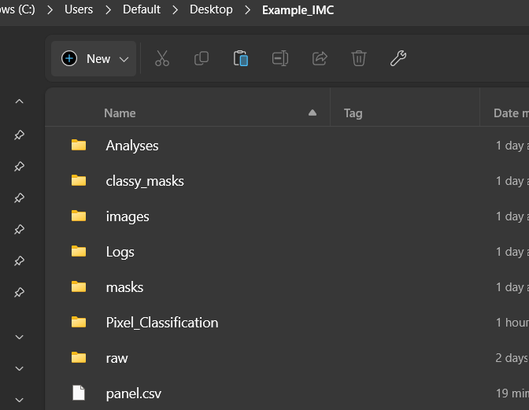
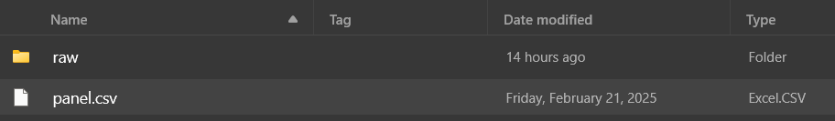
The Starting Directory Structure
part 1: MCDs and TIFFs
MCD and TIFF directory share a common starting point:
a folder with
/raw
folder containing the starting MCDs / TIFF files
On creating a project, a larger directory structure to hold all the soon-to-be derived data is made
A panel.csv file is NOT necessary, as the panel file can be autogenerated and then edited inside PalmettoBUG itself, but it also can be made beforehand.
Its format is the same as the panel file in Steinbock (on which this part of PalmettoBUG was based), with a couple changes:
- there are no ilastik / cellpose columns
- the “deepcell” column is renamed to “segmentation”
Brief Description of Each folder (in order of typical use):
-- raw: the starting folder with your MCDs / TIFF files, before filtering out any unwanted channels
-- images: a folder containing subfolders of images. The images/img is a special subfolder containing the images directly converted from the raw folder, while other folders of images can be made by the user after denoising or other image modifications.
-- masks: a folder containing subfolders of cell masks. /masks/cellpose_masks and /masks/deepcell_masks are special folders containing the cell masks generated by cellpose / deepcell algorithms. Other subfolders can be generated by the user by modifying those masks or by using pixel classifiers.
-- Pixel_Classification: contains subfolders, each with a pixel classifier & its primary outputs
-- classy_masks: contains subfolders, each with a set of “classy masks”, which are cell masks that have been classified by a pixel classifier. It also contains tables of these classifications that can be imported into an analysis as a way to cluster / label cells.
--Analyses: contains ‘analysis’ folders, each with data measured from the images for clustering, plotting, etc. Each analysis folder has the same structure as an “FCS directory” project and once created can be entered directly from the starting screen.
Notes:
4/3/2025

Slide 6
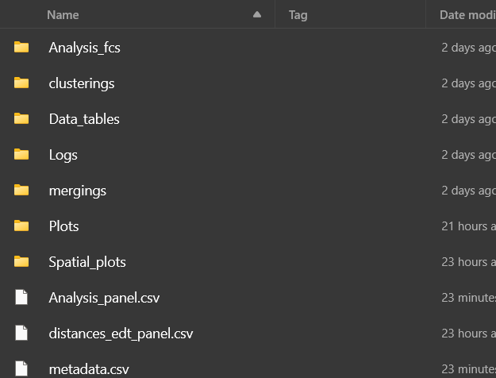
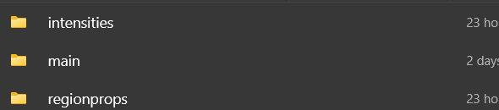
The Starting Directory Structure, part 2: FCS directory / an analysis
FCS directories have a
/main/Analysis_fcs
folder containing the starting FCS files
After starting an FCS project, the /main folder will be populated with a number of new folders
The Analysis_panel.csv and metadata.csv can be manually generated by the user beforehand, but they can also be created inside PalmettoBUG.
They follow the format of the panel/metadata files of the CATALYST package, on which this was originally based.
When derived in PalmettoBUG from an imaging project, there will also be additional folders with CSV files in them:
Brief Description of Key folders:
-- Analysis_fcs: the starting folder with your raw FCS files
-- clusterings: a folder containing .csv files of cell clusterings / groupings. These csv’s also are used for spatial analysis (in image-derived experiments).
-- mergings: a folder containing .csv files of the manual merging of FlowSOM clusters by the user.
-- Data_tables: a folder .csv files with data or statistics exported by the user for use outside PALMETTOBUG.
-- Plots: a folder containing the plots generated by PalmettoBUG
These folders will also show up after a project is made directly from FCS files, but the there will be no files inside them
Notes:
4/3/2025

Slide 7
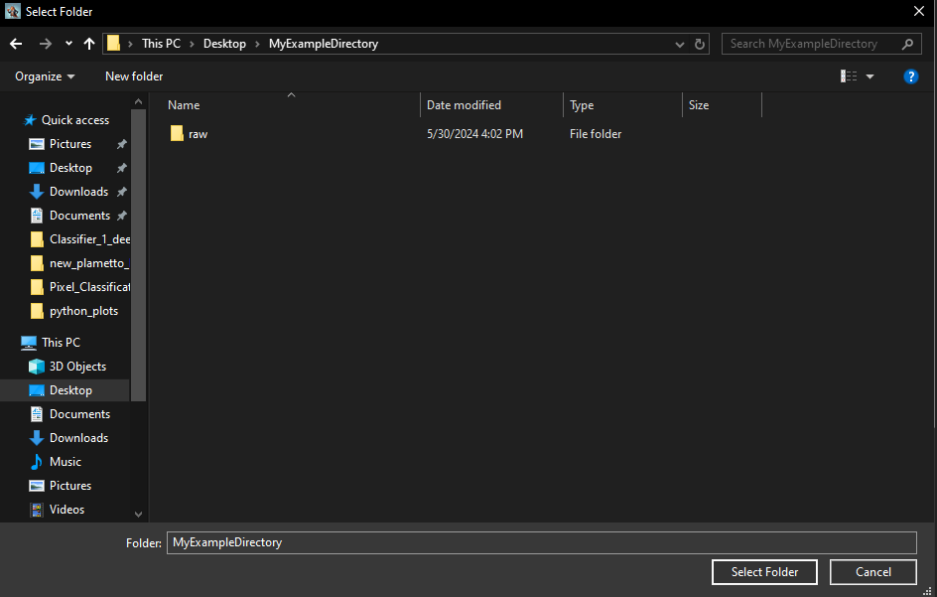
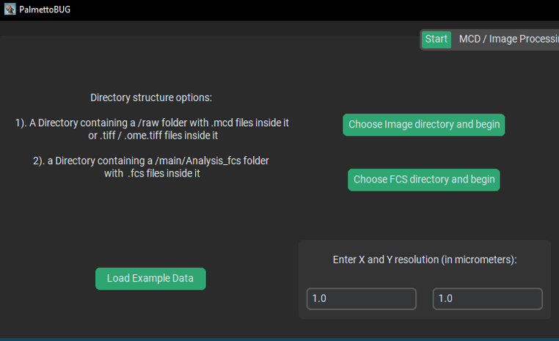
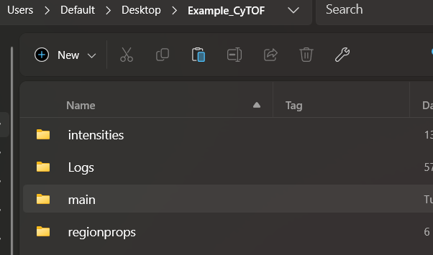
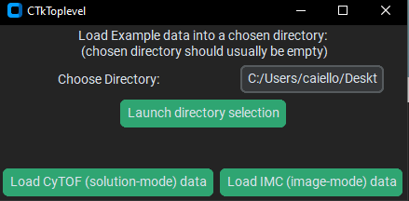
Entering a directory example
MCDs or TIFFs inside /raw
Clicking one of these two buttons launches a folder selection window.
Navigate to your desired folder and click select folder
Selecting to load the example data launches a window where a fresh (empty) directory can be selected, then either solution-mode or imaging-mode CyTOF data can be loaded into that directory
Place FCS’s inside /main/Analysis_fcs
Loading the example data automatically sets up the needed directory structure for you & downloads the example data from Zenodo (https://zenodo.org/records/14983582). This can be a slow process using Python (especially for the IMC data), and it is generally better to download the example data directly in a browser yourself, unless you are having difficultly setting up the initial directory structure
Notes:
4/3/2025

Slide 8
The Image Processing Tab
Worth a
Thousand Words
Notes:
4/3/2025

Slide 9
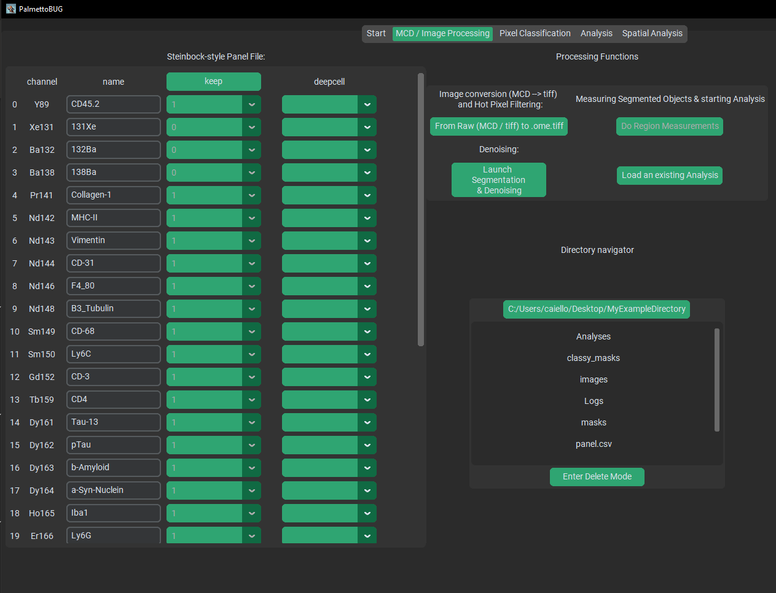
MCD / TIFF Project Starting Screen
Analysis Options / Operations.
Panel File
A Directory navigator that allows some files to be opened inside PalmettoBUG
Notes:
4/3/2025

Slide 10
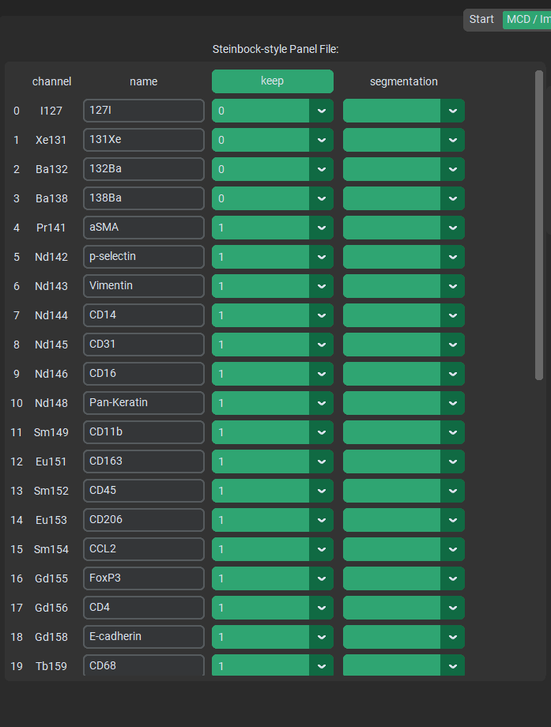
The Panel File
The keep column determines what channels to carry over from the /raw folder to the images/img folder (keep = 1), and what channels to drop (keep = 0). Background channels are frequently dropped. PalmettoBUG does its best to automatically guess what channels to keep or not.
The keep column should NEVER be edited once the /raw → images/img conversion has been made, unless you intend on immediately redoing that step!!
This is because the program expects a certain number of channels from the panel file, which must match the actual number of channels kept in the experiment
The panel file is the same / similar format as the popular steinbock package panel file (on which substantial parts of PalmettoBUG was based)
The channel column is automatically populated from the MCD. If you need to edit these, open the panel.csv file in excel.
The last column reflects channels that will be used for segmentation. A blank value, or a value of ‘nan’ (not-a-number) means the channel is ignored during segmentation.
You MUST manually select these values for segmentation to succeed!
The name column is meant to reflect the biological / memorable names of the marker in each channel. This also auto-populates from the MCDs and frequently needs no edits
At the bottom of the keep / segmentation columns there is an option to set all fields at once
Notes:
4/3/2025

Slide 11
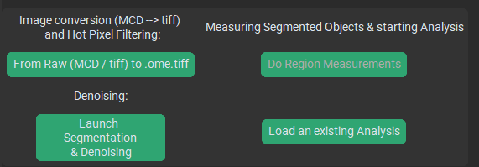
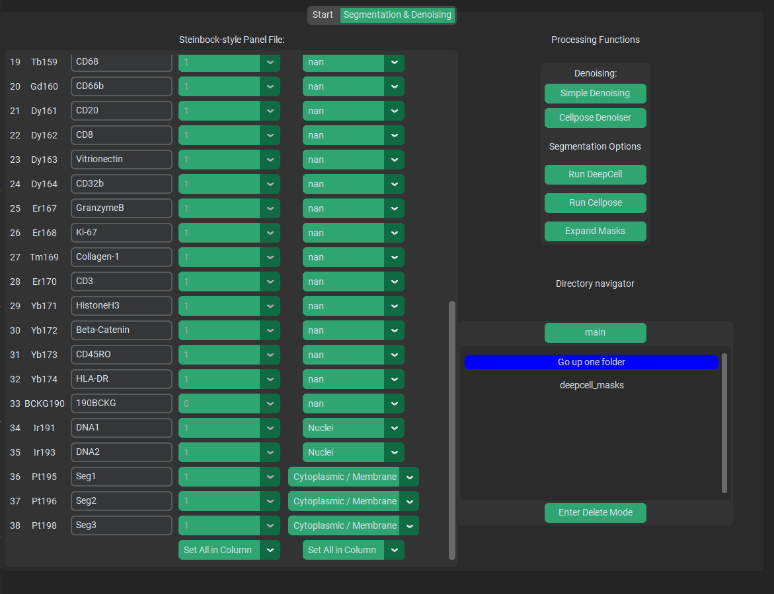
The Processing Function Bank
This reads region measurements and channel intensities within selected paired masks & images and sets up for a downstream single-cell analysis
This converts the MCD or TIFF files in /raw to .ome.tiff files inside the /images/img folder. It filters out channels that are set to keep = 0 in the in panel file and performs hot pixel filtering
This launches a separate window / program that can perform image denoising and cell segmentation.
(Kept separate for licensing reasons)
This allows you to load single-cell analysis generated from this project.
This separate denoising / segmentation window runs independently of the main program, but expects an identical directory structure for data Input/Output.
When launched from PalmettoBUG, it is passed the current directory so that the transition is seamless, but it can also be launched entirely separately from PalmettoBUG, and then navigated to the desired directory to perform denosing/segmentation.
Notes:
4/3/2025

Slide 12
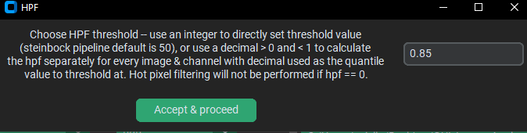
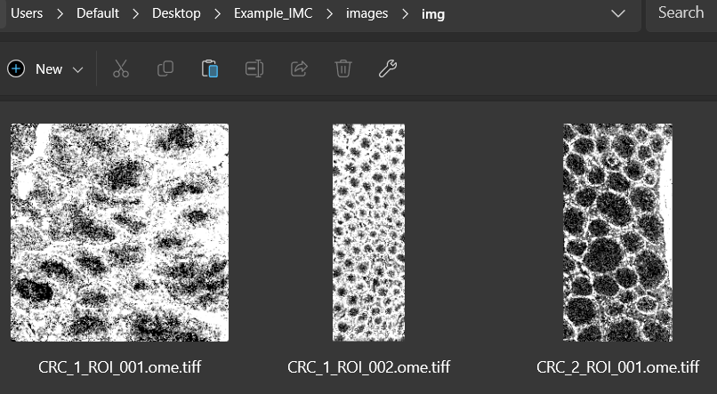
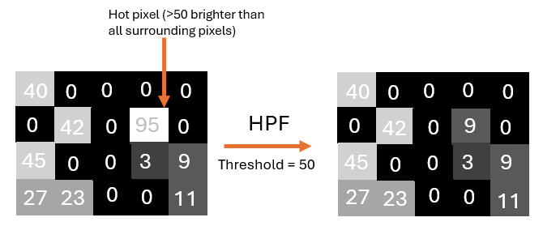
Examples 1: raw → img
Hot Pixel Filtering (HPF) reduces isolated pixels that are substantially brighter than all their neighbors
What number you choose has a strong impact on how the hot pixel filtering proceeds
What HPF does:
The /images/img directory populates with .ome.tiff images.
Much of the MCD processing screen are directly derived from the popular steinbock package: Welcome - steinbock (bodenmillergroup.github.io)
This includes the panel File, Hot Pixel filtering, deepcell implementation, and region measurements. You can see the Steinbock documentation for more details of how these steps work.
Notes:
4/3/2025

Slide 13
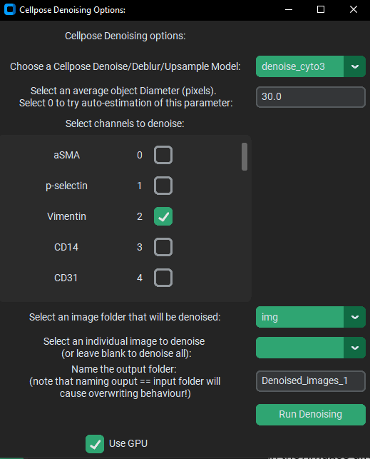
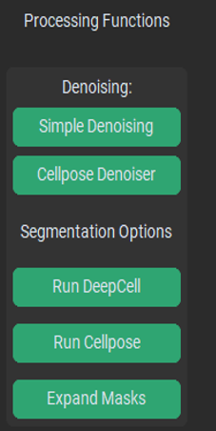
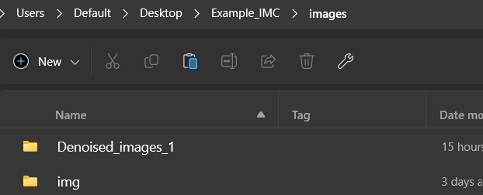
Examples 2a: Denoising
Initially, only one image folder is available to denoise (/img, the images derived from /raw), but once additional image folders has been made -- such as by performing denoising – there will be more options
Inside the separate segmentation / denoising program:
Testing how a denoising looks by running one image can be much faster than doing the entire image set
While you could try denoising every channel, this is not usually recommended.
It can take a very long time, and denoising may not be the best choice for every channel in a dataset.
In this scroll box, you can select each channel that you want to denoise
A new folder of denoised images is made in the /images directory
Notes:
4/3/2025

Slide 14
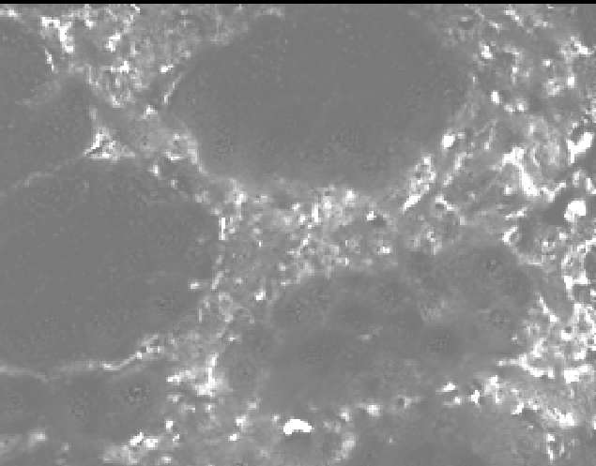
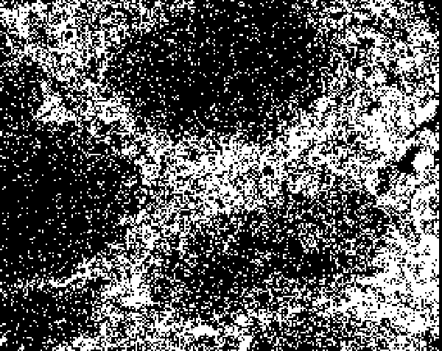
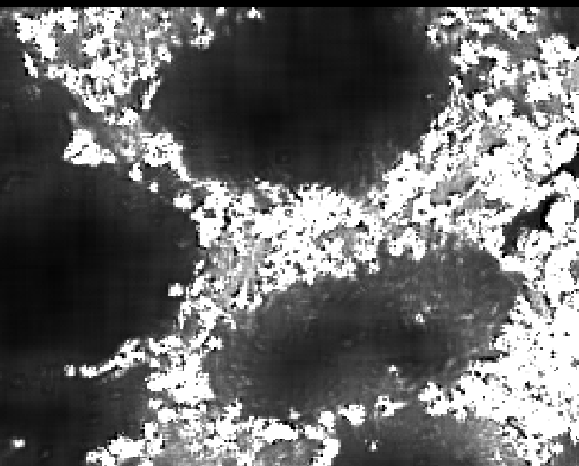
Examples 2b:
Denoising
Vimentin (raw)
Cellpose denoising
To Denoise or Not to Denoise?
Denoising is intended to remove background signal from an image while maximally preserving genuine, biological signal.
Denoising tends to ‘smooth’ images, and strictly speaking always loses information from an image. However, if that ‘information’ was random noise that was obscuring useful signal then it can be worth it.
Some level of denoising is very frequently performed in image analysis, and some of the downstream steps of PalmettoBUG – such as pixel classification – use gaussian smoothing (an even simpler simple way to combat noisy signal) regardless of whether or not an image have been previously denoised.
See how the denoised images look smoother / less obviously pixelated, with more even gradients
Simple denoising
While cellpose denoising uses a cellpose deep learning model, simple denoising calibrates a J-invariant non-local means denoising algorithm (from scikit-image) for a range of sigma values, then averages a J-invariant and a regular non-local mean denoising of the image around the calibrated sigma.
“Simple” denoising tends to be slower (taking >~1 min / image), and preserves the original intensity range of the channel, unlike cellpose which is a bit faster and normalizes channel intensities between 0 and 1.
Cellpose Github:
MouseLand/cellpose: a generalist algorithm for cellular segmentation with human-in-the-loop capabilities (github.com)
Notes:
4/3/2025

Slide 15
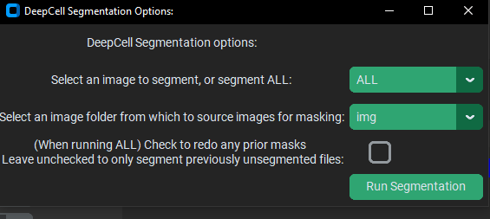
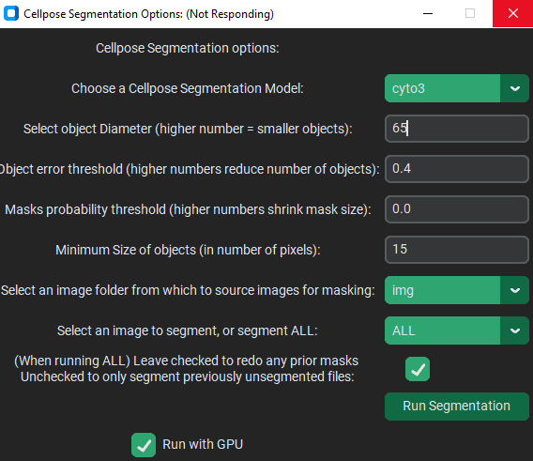
Examples 3a:
Segmentation
DeepCell vs. Cellpose:
DeepCell and Cellpose are both deep learning algorithms intended to be able to segment cells efficiently and accurately.
DeepCell requires a nuclei channel to run, while a cytoplasmic channel is optional (but needed if you segment more than the nucleus!), while Cellpose is the opposite. Remember to select segmentation channels in your panel file before running!
DeepCell is very convenient because it requires no special inputs – just point it in the direction of your images and it runs, however Cellpose runs faster and needs/allows more fine-tuning of parameters. Most critically the object Diameter parameter needs tuning. My experience is that a higher number (like ~60+) creates a better segmentation, with lower numbers causing Cellpose to find much fewer, oversized cells.
They also differ in license. Cellpose itself is also open-source, but offers a number of separate models that mostly have their own non-commercial restrictions because of the licenses of the datasets they were trained on, while DeepCell is not open-source, as it is limited to non-commercial use.
The models yeast_BF_cp3, yeast_PhC_cp3, and deepbacs_cp3 are the only potentially fully open-source models (allowed for commercial use).
Cellpose segmentation / denoising can be run (through pytorch) with a configured GPU. Deepcell, meanwhile, uses tensorflow and will automatically try to use a GPU if it is available.
Regardless of which you choose, both segmentation options prompt you for the source image folder (default = /images/img), whether to segment just one image – which is useful for testing parameters / algorithms – or to segment the entire folder of images. In case you added new images to the folder and don’t want to redo every images’ segmentation (which can be very slow), uncheck the checkbox to only segment images without masks already generated.
Because DeepCell is slower, it defaults to not redoing masks!
DeepCell docs: Examples — DeepCell 0.12.9 documentation
Cellpose Github:
MouseLand/cellpose: a generalist algorithm for cellular segmentation with human-in-the-loop capabilities (github.com)
Notes:
4/3/2025

Slide 16
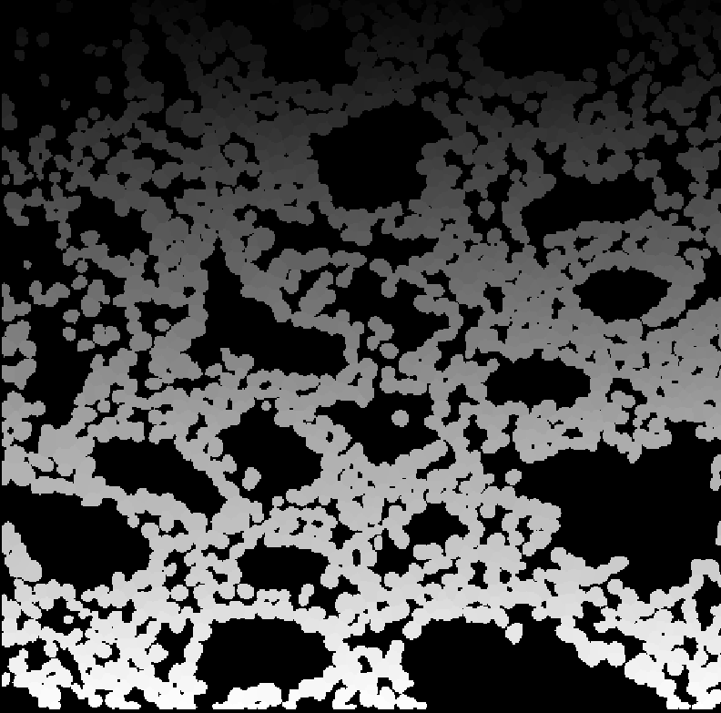
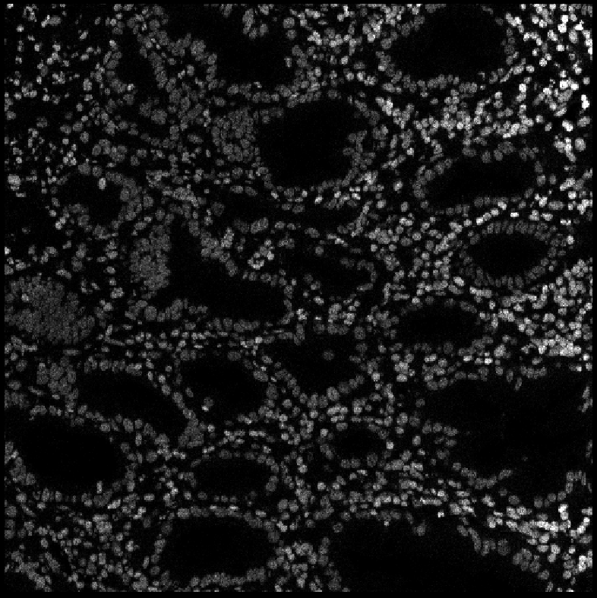
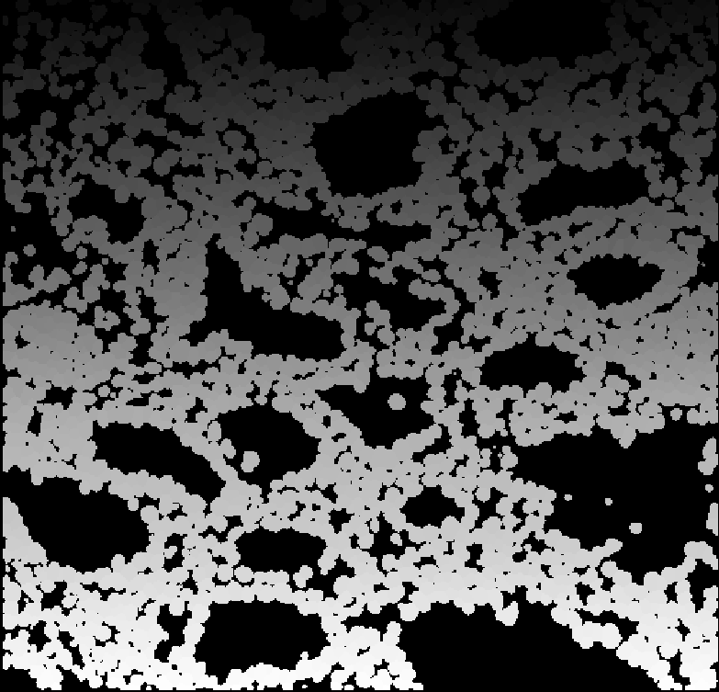
Examples 3b:
Segmentation
Cellpose segmentation
(diameter = 65, although note that proper diameter might vary between types of image / resolution. This image has 1 micrometer resolution)
Notice the gray-scale gradient of the cell masks from top to bottom. This is because each cell masks has a unique, identifying number which is displayed in Napari as a slightly different shade of gray
DNA channel:
DeepCell segmentation
Notes:
4/3/2025

Slide 17
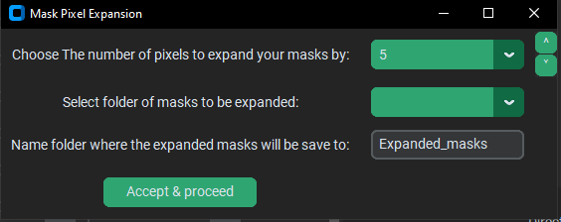
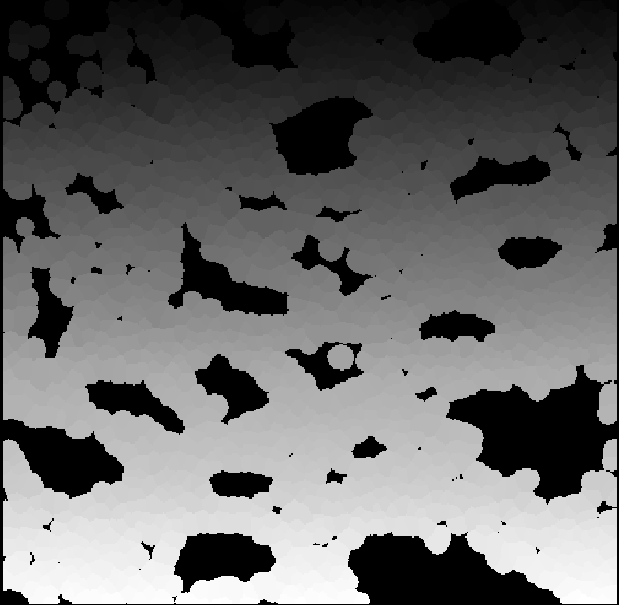
Examples 3c:
Alternate Segmentations & Expansions
Alternate Segmentation Method:
There is an alternate way of segmenting cells from Cellpose / DeepCell: Pixel classifiers.
Pixel classifiers will be discussed in more detail later, but a simple segmentation method is possible for roughly circular objects / cells using pixel classifiers.
Expansion is also particularly useful in this case as you can segment nuclei, which are usually roughly circular and then expand to capture cytoplasm.
This option simply expands the edges of every masks by the number of pixels selected (in the example below, 5 px)
When to use?
The expansion option is useful in at least two major use cases:
When the cytoplasmic markers are poor, DeepCell segmentation can be very tight around the nuclei, and not really capture any cytoplasm
It can assist the alternative, pixel classifier-based segmentation method described above
Notes:
4/3/2025

Slide 18
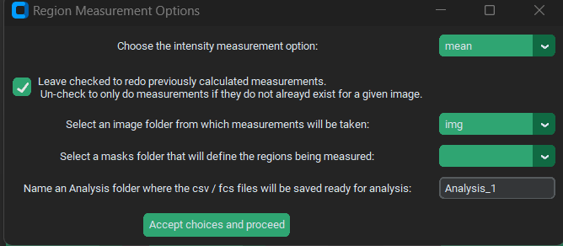
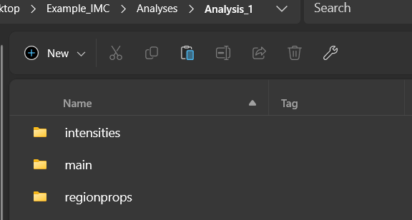
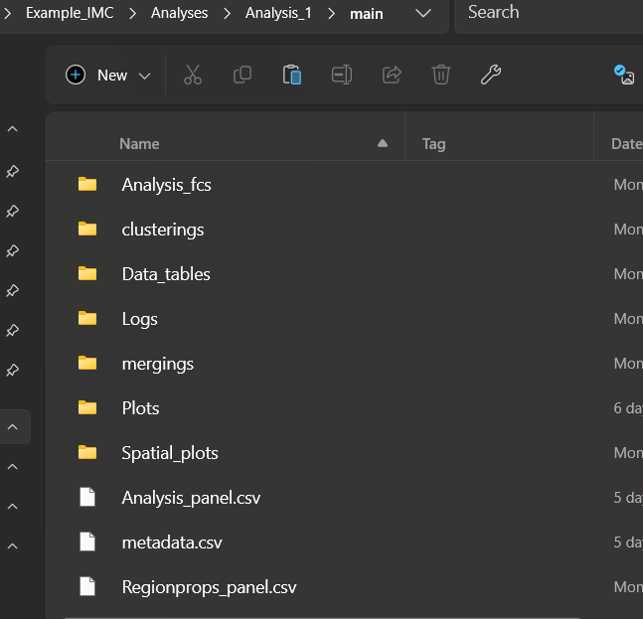
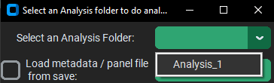
Examples 4:
Region Measurements & Analyses
This makes measurements for each mask region, with intensities for each channel being determined by the statistic (mean / median, etc.) and a preset selection of region properties (such as area, etc.) being recorded
If you create region measurements more than once (say for different masks, etc.), then multiple analysis folders will be available.
Be sure to use unique names when doing region measurements or the newest folder will overwrite the previous one!
Step 2: Load the created analysis!
A new analysis sub-folder is made in /Analyses containing the measured region properties and channel intensities in .csv’s inside the /regionprops & /intensities folders.
The /main folder can have multiple sub-folders, but at this point they should be mostly empty – they’ll be populated once the analysis is loaded
Notes:
4/3/2025

Slide 19
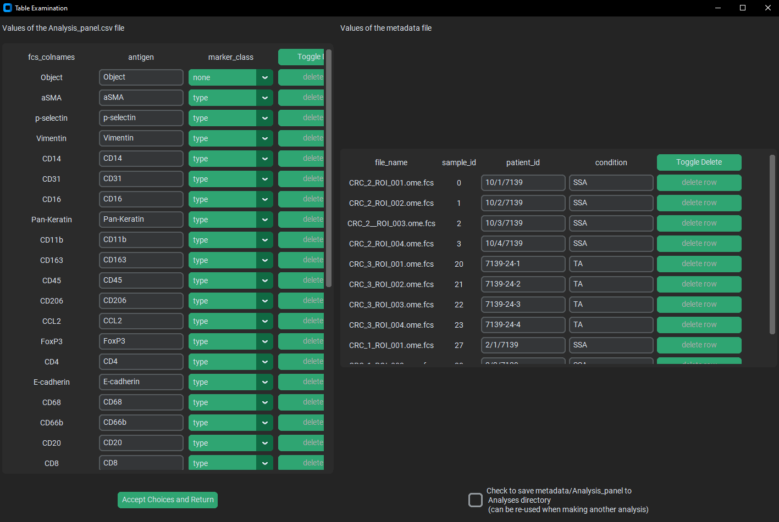
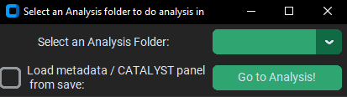
marker_class:
Type = markers to use in clustering cell lineages
State = markers to use in expression analysis
None = markers to mostly ignore (ex: segmentation markers / DNA)
The condition column is for you to annotate your variable of interest (independent variable).
Patient_id is really for any potential confounding variable or covariate, such as batch, patient, etc.
Into the Analysis!
The number of rows in the metadata file is determined by the number of FCS files in the analysis (which corresponds to the number of image files in a MCD / TIFF derived analysis)
The antigen column is for human-friendly names of protein markers that will show up on plots of the analysis (this column is often already correct when derived from images)
These checkboxes references each other:
This saves your panel & metadata file to the /Analyses folder, where it can be reused in another analysis
This will attempt to (re)use any saved panel/metadata files, so that they don’t have to be remade from scratch. If working with the example IMC data, CHECK THIS BOX!
For both panel and metadata, you can delete or add a row to the end.
Particularly for the metadata file, palmettobug will check to see if its length matches the number of files in the analysis and will perform corrective actions if they don’t match
While this analysis was originally based on / mimicking the R-language package CATALYST, the analysis code underlying PalmettoBUG is written purely in Python, with a number of differences from the original
At the bottom of the marker_class column there is an option to set all fields at once
Notes:
4/3/2025

Slide 20
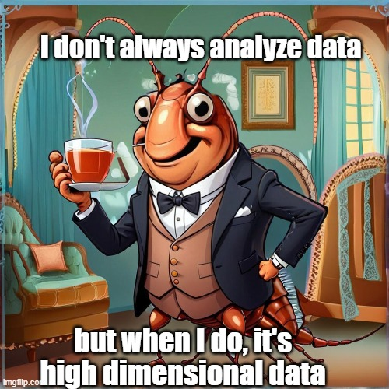
The Analysis Tab
Notes:
4/3/2025

Slide 21
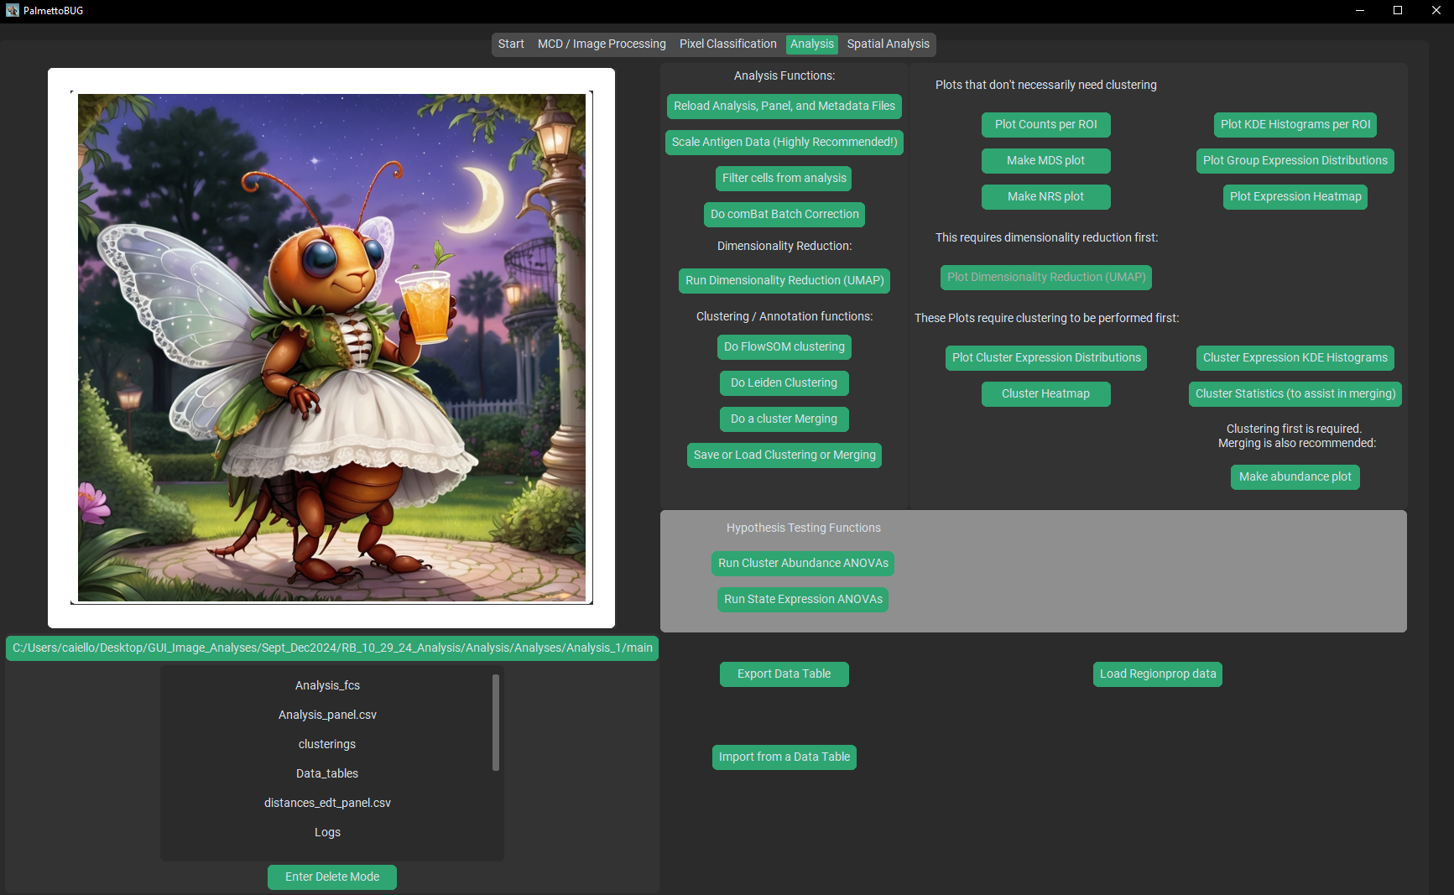


The Data Analysis Screen
As soon as you generate the first plot, Ms. PalmettoBUG will be replaced (never to return until you re-open the program!) by a display of the plot that you have generated.
Note that while it is convenient to look at the plots inside PalmettoBUG, the saved .png file is typically higher resolution & better proportioned that those in the display!
Will focus on these button next
When the data is read in, it is arcsinh / 5 transformed from the values in the .fcs files (as is typical with mass cytometry)
This directory display allows you to navigate inside the analysis folder and view previously generated plots and data tables inside PalmettoBUG
As plots are generated, they populate the /Plots folder
Notes:
4/3/2025

Slide 22

The Core Analysis options
These plots do not require clustering first, and are often done first as quality control plots
These options do not plot anything, but perform analysis steps to prepare for making plots
Important Terms:
clustering – any kind of grouping of cells for the purpose of identifying / annotating cell types
metaclustering – is the output of the unsupervised FlowSOM algorithm, which groups cells based on their features into numerically labeled groupings.
leiden – the output of an unsupervised classification algorithm, this is parallel term to metaclustering for the FlowSOM algorithm, but instead for the leiden algorithm.
merging – is the manual annotation of the groupings from a metaclustering/leiden into biologically relevant cell lineages. An unsupervised clustering should typically create “too many” small groupings which need to be merged together into larger cell lineage categories, hence the name merging. Unlike metaclustering/leiden, a merging can and should use the full name of the cell types instead of numbers.
classification – the output of a pixel classifier which has been ported into an analysis as an alternative way to group cells.
These plots require some kid of clustering (Leiden, FlowSOM metaclustering, classification, or a merging) before they can be made
The abundance plots are often the primary endpoint of users – they help display how the cell groupings vary between images and conditions.
For example: % of each cell lineage in each treatment condition
Notes:
4/3/2025

Slide 23





As seen inside palmettobug:
An Analysis Example: initial plots 1
Count plots are useful to see if there are imbalances in the number of cells / image, and may lead to dropping an image, or re-examining its segmentation if it has far too few / too many cells in the image
As an example of how the display inside palmetto bug can distort the appearance of plots, this is the appearance of this plot as it is saved to the disk:
Checking this box opens an additional window, where more detailed edits can be made to the plot appearance. However, the preset saves are usually best.
The key thing to know in this pop-up window is that what you see is exactly what you will save, and that the two highlighted buttons above are critical: one lets you edit margins & facetted plots’ internal spacing, the other is required to save the image.
For the remainder of these slides, the disk saved images will be what is shown, and not the display inside PalmettoBUG
Notes:
4/3/2025

Slide 24







An Analysis Example: initial plots 2
These plots allow visualization of the distribution and expression of the markers inside each sample id.
Using the heatmap’s dendrogram and visually comparing the KDE curves can be quite useful in identifying potential outlier images / fcs files that might be dropped from the analysis.
These allow a check of whether the images for each condition or patient_id cluster together or do not – indicating whether or not condition/patient_id drives global expression of markers in the data
Seeing the whole distribution of expression in the samples can be useful – the heatmap hides much of the detail of the actual expression
Notes:
4/3/2025

Slide 25





An Analysis Example: initial plots 3
The MDS (MultiDimensional Scaling) plot, where each dot represents a different sample_id (image), is useful for visualizing if any of the samples are outliers in the dataset.
The values of the MDS can be saved to a data table
The NRS (non-redundancy score) plot is useful for identifying which protein markers in the dataset convey the most information about the cells in the dataset, potentially indicating whether a marker is useful or not for clustering the cells
Notes:
4/3/2025

Slide 26





An Analysis Example: dealing with outliers and batch effects
Reloading the experiment resets the analysis to the state of the files inside the analysis folder.
This will undo any dropped images, batch corrections, scaling, and dimensionality reductions while unloading any metaclusterings, mergings, & classifications!
Select the column you want to filter on (can also filter on metaclustering, etc. when available in an analysis)
Dropping samples, scaling, and batch correction are not permanent – they do not change the files saved inside the analysis folder!
This means every time you re-enter or reload this analysis, these steps will be lost & need to be redone if desired!
Batch correction should almost always be done with patient_id as the batch column
Batch correction is running the scanpy.preprocessing.combat function under the hood
Note! Batch correction is undone by scaling (as in, if you scale the data after a batch correction, then that batch correction will be lost) – unless batch correction is done before ANY scaling is performed in an analysis. So you can batch correct the raw data, and then scale anyway you want, or you can scale and then batch correct – but then you cannot scale the data again without needing to redo the batch correction!
Check the categories to filter out, and then drop
No batch correction or filtering is used for the example plots in this powerpoint
Notes:
4/3/2025

Slide 27



A brief description of the scaling options
(This link is a useful resource for comparing some of the scalers offered here [ robust, standard, min_max], and getting an intuition for what scaling is seeking to do:
Compare the effect of different scalers on data with outliers — scikit-learn 1.5.2 documentation):
unscale – the raw (only arcsinh-transformed) data
min_max – the raw data, where the minimum value for each channel is set to 0, and the maximum value for each channel is set to 1.
-- as in: scaled_data = raw_data – raw_min/ (raw_max – raw_min), within each channel of the dataset.
%quantile – scales similarly to min_max, except instead of setting the maximum = 1, sets all data greater than or equal to the specified %quantile value to 1. This can help remove excessively brighter outliers in the data which can compress the values of the data into a small range.
This is my most commonly used scaling, usually at the 99.9% quantile.
standard – this is performs standard scaling, where the mean of the data is minused off each data point, then the data is divided by the standard deviation. This does not guarantee data between 0,1, unlike the previous two options.
robust – this is supposed to perform scaling similar to the standard scaler, but while being more robust to outliers / non-normal distributions of data.
qnorm – this performs a type of scaling frequently used in large genomics / RNA-seq experiments. It very aggressively fits the data from different channels into a similar distribution.
Note that all these scale within channels, and that the dataset can be freely scaled / unscaled at any point in the analysis. This means clustering can be performed with one scaling, and then plots generated with a different scaling, etc. However, scaling is not saved if you reload the analysis, so it must be redone everytime the program is closed / reopened
An Analysis Example: Scaling…
FlowSOM clustering + heatmap for unscale (left) and 99.9% scaled data (right)
Scaling can be very important to place all antigens on the “same playing field”. As in, it is a way of addressing the problem of comparing antibodies / proteins with different levels of expression or different levels of brightness in the images.
In particular, min_max, %quantile, and qnorm will scale all antigens in approximately the same range (between 0-1 for min_max and %quantile) , ensuring that particularly bright antigens do not dominate out the dimmer markers in the panel.
During clustering, such as with FlowSOM, this can mean that scaling will better identify rare cell populations defining by dimmer markers.
At the same time, scaling does make antigens in the panel have approximately equal weight – including markers with poor signal-to-noise ratios and markers that did not work at all! Be sure that all the channels in the dataset worked & have manageable signal/noise, especially when scaling.
Drop bad channels before analysis (keep == 0 in the panel when converting from MCDs) or set marker_class == “None” in the Analysis_panel
Note how the columns for FoxP3 and p-selectin have changed after scaling
-- Further plots in the examples will use the 99.9% quantile scaling
Notes:
4/3/2025

Slide 28





An Analysis Example: FlowSOM & metaclustering
These numbers 1-20 are the metaclusters
Running FlowSOM creates a “metaclustering” column in the data, which can then be used.
This number determines the final number of clusters that will be produced by the algorithm.
Minimum Spanning Tree (MST)
This heatmap can be a good starting point for identifying the cell lineage associated with each FlowSOM cluster number
While this example is using a metaclustering, this & all following functions that use clusterings can plot any cell grouping – including mergings & classifications – in a similar way
One difference from the original CATALYST FlowSOM clustering is that the data is normalized within cells first (if combined with 99.9% scaling of channels, then this closely resembles the method used in Pixie, a pixel-classifier published by the Angelo Lab). These steps may help avoid large clusters of “featureless” cells that CATALYST clustering would sometimes generate.
Notes:
4/3/2025

Slide 29




An Analysis Example:
Comparing metaclusters
Can make violinplots, barplots, or heatmaps from this window.
You may either plot the raw distributions of the markers in each clustering, or the distributions minus the mean of the other clusters to show the expression of the clusters relative to the rest of the dataset
These plots can help you get a sense of the distribution of marker expressions in the metaclusters
Notes:
4/3/2025

Slide 30



An Analysis Example:
Metacluster Statistics
The table below shows stats for cluster 16
Check the box to export the table to the /CATALYST/Data_tables directory, instead of only opening a window to view the stats
During FDR correction a small value is added to prevent errors when p = 0
Knowing which expression changes seen in the prior plots are the most statistically significant is useful while assigning biological labels to each metaclustering
Notes:
4/3/2025

Slide 31





An Analysis Example:
Dimensionality reduction (DR)
This must be run first, before a DR can be plotted.
Can do PCA or UMAP (UMAP in the example)
With facetting
Without facetting
The regions of the UMAP appear to differ substantially between the two conditions
DRs can be colored by antigen or by clustering
Notes:
4/3/2025

Slide 32



An Analysis Example:
Alternate clustering – Leiden
Unlike FlowSOM, Leiden clustering does not produce a preset number of clusters – instead the final number of clusters is automatically determined from the UMAP embedding of the cell data
These parameters affect the UMAP / neighbors graph on which the Leiden clustering is constructed.
Higher Leiden resolution = more, smaller clusters and vice-versa
This also runs a UMAP – but unlike the UMAP option discussed on the previous slide, the UMAP run with Leiden clustering always uses every cell (no downsampling). This means it can take a long time to run and the UMAP may look different!
Additionally, it will clear any previously run UMAPs from memory, so if you run a different UMAP before Leiden clustering, that UMAP will become unavailable afterwards.
If you want a prior UMAP back – re-run the UMAP with the same parameters after the Leiden clustering
Any plot that can be made with a FlowSOM metaclustering can also be made using a Leiden clustering
Notes:
4/3/2025

Slide 33


An Analysis Example:
Metacluster Merging
Pick a useful name, especially if testing more than one merging (or you previous merging may get overwritten!)
The last four slides of plots were leading us to the real goal: determining cell lineages by merging and labeling the metaclusters with biologically relevant labels
Use the prior plots, such as this heatmap, to help select sensible merging annotations
(Cluster Heatmap from 5 slides prior)
Here, we merge a FlowSOM metaclustering, but a Leiden clustering can also be merged
Notes:
4/3/2025

Slide 34




An Analysis Example:
Using a Merging – all the old plots again
Anything you can do with a metaclustering, you can do with a merging (or classification)!
Heatmaps, barplots, violin plots, UMAPs, statistics….
Do it all with biologically relevant annotations!
Notes:
4/3/2025

Slide 35




An Analysis Example:
Using a Merging part 2 – Abundance plots
You can do these plots with a metaclustering, too, but are usually not as informative or helpful as with a merging
There a few different styles of abundance plot available
Be sure to change the filename if you want to have more than one style (and not overwrite one)
Notes:
4/3/2025

Slide 36



An Analysis Example:
Saving a Metaclustering / Merging / Classification
This area is for importing cell classifications from pixel classifiers – which reside OUTSIDE the analysis, but inside the overall project directory.
Once loaded, the classification can be saved INSIDE the analysis just like a merging or metaclustering to avoid needing to load it from outside again
Any active mergings, leiden, metaclusterings, and classifications can be saved here.
Load a saved clustering from this field
These two fields determine the file name of the saved clustering
Notes:
4/3/2025

Slide 37



An Analysis Example:
Exporting Data to analyze elsewhere 1
You can choose to only keep parts of the data to export (such as only exporting certain clusters)
This separate section lets you export your dimensionality reduction numbers, in case you want to plot them in a different program
You can group the data by certain columns and export an aggregate statistic – such as the means of all the channels within each unique mergings within each sample_id
Default settings export the entire set of data to a .csv file in the /Data_tables folder
This option should be checked if your plan is to re-import the data into another copy of PalmettoBUG (it saves the marker_class information type/state/etc.).
Otherwise, it is best to leave unchecked, as it could disrupt loading the exported data into any other program
Grouped exports have the statistic type appended to the start (“mean_”data_table_1 – “mean_” was automatically added to the user-inputted filename)
Notes:
4/3/2025

Slide 38


An Analysis Example:
Exporting Data to analyze elsewhere 2
← Channel expression columns
Metadata columns →
Opening the exported data table from the previous slide in a separate program (with all the data in it – no subsetting or grouping):
Example of exported data grouped (using the mean) by the columns ‘sample_id’, ‘leiden’, and ‘condition’:
Mean values of each marker for each group of cells
Grouping columns at the start:
Each unique combination of sample_id, leiden, and condition should be represented by a row
Notes:
4/3/2025

Slide 39





An Analysis Example:
Abundance Statistics
The data is grouped by sample_id before the calculations are performed.
If you have >2 conditions, you can either do an ANOVA across all conditions, or pairwise comparisons
You can run an ANOVA or Gaussian GLM on celltype abundance %’s, or Poisson / Negative Binomial GLMs on the raw celltype count data
Writes a .csv in the /main/Data_tables folder
If you run an ANOVA, the average expression / stdev per group is calculated directly from the data.
In contrast, when doing a GLM, the avg expression / 95% CI is an estimate from the model after it was fit to the data, and is not calculated directly from the data
GLM: Poisson example
This field doesn’t update with what model you choose, so be sure to select a sensible title for the statistics table (and avoid accidental overwrites!)
p_adj = p value after FDR correction for multiple comparisons (Benjamini-Hochberg).
See: false_discovery_control— SciPy v1.14.1 Manual
A small value (1e-25) is added before doing the adjustment because a pvalue = 0 would cause an error when adjusting. This is why many of the p_adj values are the same small number.
Notes:
4/3/2025

Slide 40



An Analysis Example:
Exprs Statistics
Like the abundance statistics, the data is grouped by sample_id before the calculations are performed.
While a state / expression statistics option is provided, it is NOT RECOMMENDED, unless you have a robust way to confidently confirm consistency of expression across different imaging days / batches.
(CyTOF data can have fluctuations in raw output across different days / images that complicate comparisons like this)
Normally, you would not re-use type markers for this statistical test, but here I do for this example, as I had not specified any state markers
What grouping statistic per sample_id is used
Either ANOVA or Kruskal-Wallis test are possible
Notes:
4/3/2025

Slide 41







Miscellaneous: Scatterplot & Classy Mask options
Scatterplots are offered as a more traditional way to visualize the data.
Converting your single-cell annotation to classy masks can be another way to examine the quality of your clustering.
A good way to do this is to open your classy masks & the original images in Napari, and then check if the expression patterns match your clustering labels well.
Notes:
4/3/2025

Slide 42
The Spatial Analysis Tab
Space…
The Final Frontier
Notes:
4/3/2025

Slide 43

An Analysis Example:
Spatial Analysis
Do cell neighbors calculation
Like the previous analysis tab, this one has a field for displaying plots as they are made, and a directory navigation area (good for viewing stats tables & plots after they’ve been made)
Cell Neighbor Plots:
Do celltypes tend to neighbor each other?
Cellular Neighborhood (CN) Analysis: identify niches / neighborhoods by classifying cells according to their neighbors
Spatial plots:
Visualize your fields of view
SpaceANOVA analysis:
Identify if celltypes are closer together / farther apart than would be expected by chance
(based on Ripley’s statistics – K, L, and g)
Euclidean Distance Transform (EDT):
Depends on pixel classifiers
Calculate the distance between cells and a particular pixel class. Useful for finding distance between cells and non-cellular objects
Notes:
4/3/2025

Slide 44


An Analysis Example:
Spatial Analysis Directory Structure
Upon starting spatial analysis in the PalmettoBUG GUI, a new sub-folder with appear in Analysis/main :
Spatial_plots
Most spatial plots & data tables from spatial analysis will simply be exported into the Spatial_plots folder
However, some plots get dedicated sub-folders
Notes:
4/3/2025

Slide 45



An Analysis Example:
Spatial Cell Plots
‘masks’
‘points’
There are two options for plotting cells
Notes:
4/3/2025

Slide 46
An Analysis Example:
Spatial Analysis – Neighbor graph theory
From this...
…to this:
Cell centroids as points:
Search radius
Each cell now has a set of interactions with a set of neighboring cells, and the image as a whole image has a graph of these connections – allowing calculations on the number, character, and composition of interactions in the image.
This example uses a radius to calculate neighbors – cells within the radius distance of each other are considered neighbors – but an alternative is to select a flat number (say, N = 5) of neighbors per cell, and then find the closest N cells for each cell in the image and connect those as neighbors.
Important! Note that the distances are calculated from cell centroid to cell centroid, and not from the edges of the cells. This means that there should essentially be no cells within a few pixels of each other!
Notes:
4/3/2025

Slide 47





An Analysis Example:
Load & Neighbors
Many of the functions in the spatial portion of the program – particularly those concerned with cell neighbors – are based on / using squidpy (scverse/squidpy: Spatial Single Cell Analysis in Python)
These parameters help determine what cells get counted as neighbors.
See squidpy documentation, and 1.6. Nearest Neighbors — scikit-learn 1.6.0 documentation for details on the algorithm being used
This creates the neighborhood connections and activates the spatial buttons dependent on neighborhood analysis
Here I facet by condition – which means that three separate neighborhood enrichment graphs are made, one using all the data, and then one for each unique condition in the dataset (in this case, 2)
The interaction matrix shows the raw counts of neighbors between each cell-celltype pair, while the neighborhood enrichment show the z-score difference between the observed interactions vs. expected interactions (via a permutation test).
This means the interaction matrix is biased by which celltypes are more abundant, while the neighborhood enrichment plot is not.
Notes:
4/3/2025

Slide 48





An Analysis Example:
Neighbor Centrality
The centrality function is just a wrapper on squidpy’s centrality graph / plotting methods (squidpy.gr.centrality_scores — squidpy documentation),
Which in turn use NetworkX (Software for Complex Networks — NetworkX 3.4.2 documentation) functions.
Degree Centrality = does this celltype frequently neighbor different celltypes?
Closeness Centrality = how close is this celltype to other cells?
Average clustering = Are neighbors of this celltype also neighbors of each other?
There a three types of centrality plots available
Notes:
4/3/2025

Slide 49

An Analysis Example:
Spatial Analysis – Cellular Neighborhoods
Example of a cell plot, colored by either cell type or an un-annotated cellular neighborhood clustering
For each cell, look at the composition of its neighbors – what is the fraction / percentage of each cell type in the cell’s neighbors?
Now, each cell is grouped by the cell types of its neighbors, using Leiden or FlowSOM clustering. These groups can later be annotated for biological labels (such as “CD8+ enriched tumor” or the like)
0 / 67 / 33
100 / 0 / 0
33 / 67 / 0
33 / 67 / 0
0 / 67 / 33
Unsupervised clustering into “cellular neighborhoods” (CNs)
by FlowSOM or UMAP + Leiden clustering
% Blue / Orange / Green
Notes:
4/3/2025

Slide 50



An Analysis Example:
Spatial Analysis – Cellular Neighborhoods
Once created, a Cell Neighborhood annotation can be saved
Allowing it to be reloaded later without needing to re-run the clustering
Cellular Neighborhoods are calculated by looking at the mixture of celltypes within each cell’s set of neighbors
Choose the annotation for celltypes
Choose the clustering algorithm
Parameters for each clustering algorithm differ
Running CN clustering automatically adds a ‘CN’ column to the Analysis, which allows all the plots shown in previous tab of the program (‘Analysis’) – such as UMAP, abundance plots, heatmaps, etc. – to be made using CNs as the annotation (instead of metaclustering/merging/leiden/classification)
Notes:
4/3/2025

Slide 51





An Analysis Example:
Spatial Analysis – Plotting CN special plots
For FlowSOM, a Minimum Spanning Tree can be generated, which shows the clusters and their relationship to each other, as well as the ‘expression’ (in this case celltype %) of the various channels fed into the algorithm
These plots are ONLY available when the CN clustering is first made – they will not be available on the reload of a neighborhood clustering
For Leiden, a UMAP can be generated, colored by the Cellular neighborhood clusters identified by the leiden algorithm
Notes:
4/3/2025

Slide 52




An Analysis Example:
Spatial Analysis – Plotting CN composition
Notes:
4/3/2025

Slide 53




An Analysis Example:
Spatial Analysis – Annotating CNs
Accepting the cluster merging instantly updates and overwrites the CNs to reflect the new labels (the prior numerical clustering will become unavailable). If you want to plot more with the underlying numerical clustering, save it before merging so that it is easy to reload!
Use plots like these to annotate the clusters.
This is essentially the same process as before (slide 35)
CNs can also be plotted using all the functions in the ‘Analysis’ tab (here an abundance boxplot):
Here I do a lazy, non-specific annotation based on the heatmap’s dendrogram
Notes:
4/3/2025

Slide 54


An Analysis Example:
SpaceANOVA
Permutation correction is highly recommended as it corrects for holes / irregularities in the distribution of cells in the images. However, it does substantially increase the time needed to run the analysis
The Ripley’s K statistic (from which L and g are derived) is calculated here in the same way as in the spatstat R package, using Ripley’s isotropic edge correction. However, all the code is written / translated in python (there is no R in this new version of palmettobug)
By default, the spaceANOVA compares all conditions at once – but you can select a pairwise comparison instead
The overall code underlying this spatial analysis option is inspired / derived from MUSC’s Dr. Souvik Seal (see his spaceANOVA R package) who also advised me and helped me test my code for accuracy in replicating spatstat
The radius parameters determine at what distances Ripley’s K, L, and g will be calculated
If there are fewer cells than this threshold for a given celltype in a given image / sample_id, then that celltype will be ignored in that image.
Notes:
4/3/2025

Slide 55






An Analysis Example:
SpaceANOVA theory
Of course, the actual calculation of Ripley’s statistics in PalmettoBUG is more complex than this example, as ALL the relevant points / cells in each image are simultaneously contributing to the final K / L / g of that image, yet not every cell is relevant, since there is a pairwise comparison aspect to the statistic – only calculating from cells of one cell type to cells of another cell type, not from all points to all other points
Ripley’s K is calculated by the cumulative count of points within increasing radii of a set of points
Ripley’s g can be thought of as looking at concentric rings around each cell, instead larger circles
Search
radius
Search
radius
Ripley’s g (pcf) is effectively the first derivative of K / L, corrected such that its value is:
g = 1
The theoretical value of K in a truly random point patten is simply:
K = point density * πr²
Ripley’s L is a corrected version of K such that the function’s theoretical values is:
L = density * r
When points are closer to other points than would be expected by chance, values of the Ripley’s statistics are greater than the theoretical values (orange line), and the opposite when points are farther away than expected.
Notes:
4/3/2025

Slide 56




An Analysis Example:
SpaceANOVA Ripley’s statistics plots
The g statistic is the easiest to interpret as the expected graph for a random process is a flat line at y = 1.
Values of Y above indicate association of the celltypes, while values below 1 indicate “repulsion” between the cell types.
The g statistic is also the function used for the functional ANOVA (on the next slide)
Select a celltype—celltype comparison
Select the statistic to plot (K, L, or g)
This checkbox adds the second panel (‘f values’) to each plot.
These represent the f statistics from individual ANOVA tests at every radii along the graph.
Notes:
4/3/2025

Slide 57




An Analysis Example:
SpaceANOVA functional ANOVA
The functional ANOVA compares the Ripley’s g statistics between each condition (remember that each image / sample_id has its own Ripley’s g, creating a distribution of functions to compare), asking the question – do the celltype’s change in association with each other after treatment?
Select which stat functions to compare by fANOVA between conditions (K & L should return identical results)
The functional ANOVAs are run when this button is clicked, so it can take a second for the window to appear
Both heatmap and Exported Data goes to the Spatial_plots folder, under the selected filename
Unadjusted for multiple comparison
This choice determines which p-value is used for both the export and the heatmap
FDR-adjusted (Benjamini-Hochberg)
As often happens, the adjusted p values can all end up being ~= 1, which is not very interesting to look at.
Note: the p-value adjustment currently uses ALL the p-values in the matrix (celltypes ^ 2) as if they are independent hypothesis tests, even though symmetrical comparisons (such as a vs. b & b vs. a) tend to have very similar – although not identical – values.
These p-values are the unadjusted
Notes:
4/3/2025

Slide 58


An Analysis Example:
Spatial Analysis – Euclidean Distance Transform (EDT) description
The ‘Normalization’ option for EDT means that the aggregate EDT value of each cell is divided by the average EDT of the entire image that cell is in.
Since images with less pixels of the class of interest will have usually higher EDT values throughout the image, this normalization is a way to better isolate the effect of the cells’ relative position to the pixel class while controlling a bit for the total abundance of that pixel class.
This technique is particular useful for calculating the distance between non-cellular objects (which can be identified by pixel classifier) and cells
EDT map:
brighter = higher distance values / farther from the pixel class
Pixel classifier output
(blue is the class of interest here)
Cell masks
(in this case from DeepCell)
Read an aggregate distance measurement of for each cell mask (mean, median, or minimum distance-from-pixel class per cell).
These intermediate EDT maps can optionally be saved into a folder when running the calculation
Notes:
4/3/2025

Slide 59




An Analysis Example: Spatial Analysis – Euclidean Distance Transform
Previously run EDTs are saved under the name of their source classifier (so loading from two identically named classifier will overwrite), and can be reloaded without needing to be redone
The marker_class determines where the EDTs from this classifier can be used. If you want to use the functions in the ‘Spatial analysis’ tab of the program, leave the default as here.
If you want to use the EDT calculations in the prior, ‘Analysis’ tab with all its options for plotting and clustering, use one of the other options
The path to the classifier is easiest entered by clicking ‘ fin in file explorer’ which opens a window that allows you to navigate to a Pixel Classifier folder. Selecting that folder then loads it into the entry field
Note(!): when the EDT data is loaded into the Analysis, it will be scaled to match any previous scaling of the data, such as 99.9% quantile, min_max, etc.
If you have previously scaled your antigen data, but don’t want that for the EDT, then unscale everything in the Analysis tab before making the EDT plots.
Smoothing removes regions smaller (by pixels) than the selected number, “smoothing” them into the surrounding pixels by looking for mode of the surrounding pixels
Notes:
4/3/2025

Slide 60




An Analysis Example: Spatial Analysis – Euclidean Distance Transform plots
Critical! There must be at least two distance transforms loaded with marker_class as ‘spatial_edt’ for the heatmap to be plotted. If this condition is not met, no window will be launched
You can plot the distance transform values by celltype (as here) or for the whole dataset (set clustering to none)
Notes:
4/3/2025

Slide 61


An Analysis Example: Spatial Analysis – Euclidean Distance Transform stats
Remember than lower EDT values indicates closer proximity to the pixel class
This performs the same statistical analysis as ‘State Expression ANOVAs’ in the Analysis tab – however, in this case only on the marker_class ‘spatial_edt’ in order to only look at EDT values.
You could instead set the EDT values’ marker_clas to ‘type’ or ‘state’ when loading them, and then run statistics using the function in the Analysis tab. (Doing it this way would simultaneously do stats on any of the other, traditional antigens you classified as type/state markers.)
Notes:
4/3/2025

Slide 62
The Pixel Classification Tab
I’m quite classy, quite classy indeed!
Notes:
4/3/2025

Slide 63




Biological_labels.csv:
Associate each numerical class with a label, used in merging classes. Manual annotation by the user for unsupervised classifiers
Pixel Classification Outputs
For supervised classifiers, the labels .csv is effectively generated before the classifier is used
Merged Classification Map (secondary output):
“background” classes are set to zeros (black), pixels in the same biological label merged into one numerical class.
A supervised classifiers’ primary output already has unique biological classes, so the only affect of merging is to convert background pixels to zeros.
Classification Map (primary output):
Each pixel is placed in a numerical class, which can then be associated with a biological label.
This example is from an unsupervised classifier.
A heatmap can assist in annotating an unsupervised classifier’s output
Merged maps are made whenever biological_labels are created / accepted, and are automatically made when a supervised classifier predicts (since these classifiers being with labels available)
Notes:
4/3/2025

Slide 64



The Pixel Classification Directories
Some folders only appear if you perform an action that needs them (like whole class analysis)
/Pixel_Classification is the primary directory for classifiers, but /classy_masks is an important folder dedicated to a particular kind of classifier output
/training_labels contains the user-created labels used to train a supervised classifier (supervised classifier folders ONLY)
/classy_masks will be discussed in a later slide
/merged_classification_maps contains the merged output
The biological_labels.csv is where the user annotations used in merging are stored
/classification_maps contains the primary output of the classifier (.tiffs), where the name of each file should match the name of the image it was derived from
/Pixel_Classification contains subfolders, one for each classifier created by the user, including both supervised and unsupervised classifiers. Unsupervised classifiers are always saved in the subfolder starting with “Unsupervised_”
The .json files contain information about the classifier that should allow them to be recreated/retrained if needed -- or in the case of supervised classifiers, they can be reloaded directly without retraining
Notes:
4/3/2025

Slide 65

Pixel Classifier creating window
This tab is where pixel classifiers are primarily used inside PalmettoBUG as part of a project – such as modifying images or masks.
More on this tab & its functions on a later slide…
This frame handles the training of SUPERVISED pixel classifiers
This frame handles saving / loading pixel classifiers & ascribing biologically relevant labels to their outputs
This frame handles predictions (after training)
This frame handles the special case of generating segmentation masks from a SUPERVISED pixel classifier
Notes:
4/3/2025

Slide 66




Choose a name (be very careful about overwriting prior classifiers!)
Pixel Classifiers making a new classifier
Start here
Supervised vs. Unsupervised Classifiers:
Supervised:
  Require more user expertise / intentionality in labeling regions
  Only will classify pre-designated classes (you have to know what you are looking for!)
  Are cleaner / more precise for identifying the classes of interest
  Implementation based on QuPath pixel classifiers
Unsupervised:
  Do not require user input
  Does not need preset classes, but output requires user merging & labeling for meaningful categories
  Implementation based on Pixie / ark-analysis method using FlowSOM
Supervised and Unsupervised classifiers have different setup windows, and different workflows
Notes:
4/3/2025

Slide 67

Pixel Classifiers making a SUPERVISED classifier
You must know what classes you intend on generating beforehand! Background is always the first class (it is handled differently by palmettobug under the hood)
Multiple Sigmas and multiple features can be selected.
Features provide different information from a raw image
Important! Remember / write down the number associated with each class. You will need these later.
They can also be retrieved from the biologicals_labels.csv associated with the classifier.
Select the Channels to use to train the classifier. IMPORTANT: do not include channels with poor signal just because you can – it might impact a classifier’s performance in terms of both speed and accuracy
Sigmas are the different levels of Gaussian blur to use for generating features – higher numbers means more intense blur / larger gaussian kernels used in blurring.
Every selected channel will have an image training layer generated for every feature at every sigma – This means that the final size of the training data expands rapidly with multiple selected sigmas / features:
Training data size = (# of sigmas) * (# of features) * (# of channels) * (# of training pixels)
Notes:
4/3/2025

Slide 68


Pixel Classifiers making a SUPERVISED classifier – Features & ADVANCED
Features: what they are and how to use them
These features are transformations of the underlying images that can provide additional useful information to the pixel classifier. Gaussian is default as it represents a plain blurring of the image, while the other features do more radical transformations of the data. For example:
Hessians (especially the hessian minimum) and the Laplacian use kernels that calculate the derivatives of the image, and can help identify edges / area of sharp transition in a channels’ intensity.
The implementation of these features were directly translated from QuPath into python. See QuPath’s documentation for more infor about features → (Pixel classification — QuPath 0.5.1 documentation)
  One piece of advice from the link above I’ll copy here: “…it can be much more effective to use a smaller number of well-chosen features rather than throwing them all in to see what comes out the other end.”
Here what it would look like to add a single hidden layer of 20 neurons (not actually done in the example classifier)
These advanced features are not commonly necessary to change. They influence the training and structure of the neural network. Adding 1-2 hidden layers is the most likely “advanced” edit.
Notes:
4/3/2025

Slide 69




Training a Supervised Classifier, part 1
Use the drop downs to select the folder of images you want to train from, then select first image you want to train from, then launch it in Napari
WARNING! WARNING!
Do not interact with other PalmettoBUG windows when Napari is open for this step. This can cause the program to crash entirely!
This issue only occurs when napari is opened with this button, not when napari is opened in any other way (inside PalmetoBUG or outside or it). This is because the python GIL / threading lock is held by napari for this step, and the PalmettoBUG GUI must wait for information from napari (the training labels) to be returned to it before it can continue running.
Launching napari can take some time.
It will open in a new window separate from PalmettoBUG
You should see two image loaded in napari:
A “layer” image. This starts out blank until you add labels to it. These will be the training labels that we are trying to generate
The image itself
The scrollbar at the bottom should allow you to look through the various channels of the underlying image and identify area on the image that match the classifications for training
Notes:
4/3/2025

Slide 70





Training a Supervised Classifier,
part 2
Displaying the classifier details can be quite useful, particularly for remembering which class / channel number corresponds to which class / channel.
Open the details window BEFORE launching Napari for training labels – you will not be able to open this window afterwards until Napari is closed!
Set the label number to the number that corresponds to the class you are trying to making training labels for (in the example’s case, this is background / 1).
Once done, just close the Napari window
Select the brush icon to generate labels.
Change the brush size for greater control
Ignore any warning (close anyway)
Label = Colon_epithelia (2 - blue)
Label = Lumen / ‘background’ (1 - red)
Labels
Image
Notice: How some of the training labels for both pixel classes are very close / adjacent to each other.
This is generally a good idea, as it can help the classifier distinguish between classes at their border regions.
This label ‘layer’ must be selected in for labels to be generated.
However, you may need to select the image itself and adjust the contrast limits to see the channels of interest before making labels
The channel displayed behind the labels here is BetaCatenin, in this case channel 26 of the dataset
Notes:
4/3/2025

Slide 71



Training a Supervised Classifier,
part 3
If you close a labeling window, and then try to launch another image without saving / discarding the first image’s labels, PalmettoBUG should get irritated and throw a warning:
Now that you have closed Napari, you must save the labels you generated!
If you don’t want the labels that you made, they can be discarded
Repeat the Labeling process for as many images as you want. The goal is to get a representative sampling of the diverse contexts each class might show up in your dataset, so that the classifier can successfully identify every class in most / all of those contexts.
Once you have created / saved all the training labels that you want to, all that is left to training is to do it!
Notes:
4/3/2025

Slide 72





Training a Supervised Classifier,
part 4 → prediction
Once the prediction is complete, view the classification map generated through the directory navigator:
Doing a single image is a good way to see if the classifier is working at intended without needing to wait for it to run on the whole dataset
Select the classifier of interest
The image folder the classifier was trained on is (usually) the image folder you should select for prediction as well
Select the Pixel_classification folder
Select the folder containing the classifier’s output
Click on the image name to launch in Napari, or toggle to “Quick Display” first to see what the pixel classifier predicted!
directory to a single pixel classification map = {project name}/Pixel_classification/{classifier name}/classification_maps/{image name}
Notes:
4/3/2025

Slide 73



A Supervised Classifier’s output: the classification map
Channel 6 → (panKeratin)
Red is background (1), epithelial pixel class is blue (2)
Instead of launching in Napari, you can display inside PalmettoBUG using the “Quick Display” toggle button.
Notes:
4/3/2025

Slide 74




A Supervised Classifier: saving & reloading
A folder for each uniquely named pixel classifier is automatically created inside the /Pixel_classification folder. For supervised classifiers, the weights of the neurons in the ANN MLP can be saved and reloaded for use later
This option menu display supervised classifier previously created in the project .
Simply selecting one will load it
Loading from the local project is instantaneous, but loading from PalmettoBUG’s Assets folder has a few extra steps:
If you think that a pixel classifier might be reusable – perhaps because the training set was extremely large, or the training dataset is similar to the new dataset it will be reused on – Then PalmettoBUG allows to save the classifier into the PalmettoBUG program’s Assets folder, where it can then be loaded into any project on your computer.
To load from assets:
You need to name the classifier in the local project
You need to confirm / fix the channel order (beta-catenin may not be the 26th channel is every dataset!)
If you need a reminder of what channels correspond to what numbers in the dataset, click here:
Notes:
4/3/2025

Slide 75


A Supervised Classifier:
Details and Biological labels
The same kind of heatmap that is plotted for unsupervised classifiers can be re-created directed from the pixel class predictions in the pixel classifier’s folder
The Biological Class Labels button will show you what number in the pixel classification map corresponds to what label.
This window also allows the labels to be edited after they are first created (don’t edit background for supervised classifiers!)
Notes:
4/3/2025

Slide 76




A Supervised Classifier: the special case of direct segmentation
These parameters control how small the masks can be & how far apart they must be
Pixel classifier trained on H3 / DNA1/2 to identify nuclei:
Classifier output broken up into segmentation masks:
Expanding the masks by a fixed amount could then be a way to capture the cytoplasm as well:
Note that this works decently only when objects you are trying to segment follow at least two of the following constraints 1). Non-overlapping, 2). Similar size, 3). Evenly spaced from each other
Notes:
4/3/2025

Slide 77

The Unsupervised
Pixel Classifier
For unsupervised pixel classifiers, training is done at the same time as when features are chosen
Select what channels to use in the classifier (by default channels are NOT used!)
Like with the supervised classifier, channels with poor signal should be avoided, however, unlike supervised pixel classifiers, you don’t always know what biological categories will be identified, so all lineage markers with good signal should be included!
Select additional features to use in the classifier here. These are the same features as for the supervised classifiers – except the gaussian is not shown as it is always calculated for every channel used & selecting a feature for one channel applies that feature ONLY to that channel (unlike supervised classifiers, where, for example if the Laplacian is calculated, it is calculated for all channels)
These parameters affect training. For example, higher training cycles takes longer, but can lead to a more stable classifier.
For unsupervised pixel classifiers, only one sigma level for blurring is used
This parameter determines the final cluster number
After classification, you can optionally smooth out isolated pixels.
This can help remove some of the noisiness in a classifier.
Quantile determines how the channels are initially scaled
Increasing the number of pixels sampled can substantially increase the computational burden of the algorithm
Notes:
4/3/2025

Slide 78

The Unsupervised
Pixel Classifier – prediction & output
Unsupervised classifier output looks like a bit of a mess here – in part because we’ve classified essentially only a few cell types + background as many different metaclusters. This is why the next steps – cluster merging and labeling are critical
Prediction is done in the same way / with the same widgets as with a supervised classifier: Select the image folder / image you want and choose to classify the whole folder or that single test image
Notes:
4/3/2025

Slide 79

The Unsupervised
Pixel Classifier – identifying biological labels
When opened in Napari from the pixel classification tabs’ directory display, an unsupervised classifier’s output will be overlayed with the corresponding image in /Images/img folder (non-denoised / uncropped image)
This allows easy spatial exploration of where different classes are in relationship to channels in the original images.
Changing the opacity of the upper layer is a good way to quickly see both the raw image and the pixel class prediction
The next step is merging the various clusters produced by the unsupervised classifier into biologically relevant labels
This process (FlowSOM overclustering, then merging) is the same process used in the FCS Analysis portion of PalmettoBUG to cluster cells.
Notes:
4/3/2025

Slide 80



The Unsupervised
Pixel Classifier – assigning biological labels
Assign labels as best as possible, based on the heatmap, but also the image – checking to see how the cluster actually looks in the data can be incredibly useful for identifying cluster.
Also, this direct, visual exploration of the data is needed if you use features like hessians, since it is hard to interpret what a high or low hessian value means biologically with only the heatmap.
Notes:
4/3/2025

Slide 81



Now, to use a Pixel Classifier….
Whole class Analysis:
See what percentage of the images in each condition are in each class, and see what change in protein markers may be occurring in each class as a whole.
Example:
Is the percentage of pixels classified as beta-amyloid plaque higher or lower in treatment vs. control tissue sections?
CRITICAL: You must first Select one of the classifiers created / loaded inside the project!!
This dropdown determines what classifier’s output is being used in the rest of this tab.
Filter Images:
Crop images to where particular classes are.
Example:
Crop images to only include villi / crypts in a colon section
Mask Merging:
Merge cell masks that have been classified (required classy cell masks first!) with the surrounding pixels that match their same class
Example:
Segmentation of unusually shaped cells (astrocyte, neuron, etc.) can be difficult with standard algorithms that expect more circular cell types – pixel classifiers can capture those shapes but segmentation afterward can be a challenge – why not get the best of both worlds?
Classy Cell Masks:
Classify separately-generated cell masks as different cell types (can be loaded into an analysis later). Also necessary to merge masks.
Example:
Using supervised a pixel classifier to directly identify cell types in their spatial context, (instead of doing the typical, spatially-agnostic clustering from FCS files).
Notes:
4/3/2025

Slide 82


Image filtering with
a supervised classifier
Colon epithelia pixel class (blue):
As in this example, sometimes the minimal bounding rectangle of class is almost the entire image size – and very limited cropping occurs — because the class of interest (‘colon epithelia’) spans all the edges of the image.
However, because I checked the “Zero-out” option, we can see that DNA signal outside colon epithelia regions is gone
Why do this?
Maybe you are only interested in a particular tissue layer that you can isolate from the overall images with a pixel classifier, or perhaps running the full size images is too computationally intensive and a bit of cropping first is helps relieve the load.
DNA channel:
The name of sub-folder that will be created in the /images folder
Selecting this checkbox (not usually recommended, but is much more dramatic for the example here) will convert all pixels outside of the selected class(es) to value 0 in all channels.
Classes show up here.
Check those you want to keep during the filtering process
Adding padding can help preserve information that might not be inside the class of interest, but is nearby enough to matter
Notes:
4/3/2025

Slide 83




Whole Class Analysis with
a supervised classifier: setup
Mainly relevant for unsupervised classifiers, where merged classification maps are usually recommended, in supervised classifiers the main distinction between these two in supervised classifiers is whether you want the “background” class to be included in the analysis.
Step 1:
Create measurement – this generates measurements based on the aggregation method of choice for each class in each image of the dataset
Step 2:
Generate the panel / metadata file (same as for a standard cell / FCS based analysis). PalmettoBUG tries to load a prior panel / metadata file from the existing analyses to save time (presumes similarity). If no Analysis_panel / metadata file exists, it should try to generate a fresh file for each.
Notes:
4/3/2025

Slide 84


Whole Class Analysis with
a supervised classifier: results 1
Whole Class Analysis makes a few pre-set graphs, with a limited set of options
The bar (or violin) plot shows the intensities of each marker, arcsinh / 5 scaled in each condition
Switch between classes
Notes:
4/3/2025

Slide 85


Whole Class Analysis: results 2
Same export data method as for standard FCS-based analyses
Notes:
4/3/2025

Slide 86





Primary Classy Masks:
Each individual mask from DeepCell has its unique, identifying value replaced with a class number (that is shared with all other masks in the same class) derived from a pixel classifier’s output
Classy Cell Masks: what are they?
Classification .csv’s:
The same process that creates the classy mask also create a .csv file of the classification choices made for each cell – this can be merged into an analysis as a way to cluster cells instead of performing the usual FlowSOM / merging inside the analysis itself.
If a FlowSOM / merging is performed, then a secondary classification .csv will be generated – this secondary .csv will have preference over the pre-merging classification .csv when PalmettoBUG tries to load it into an analysis.
Why?:
1. Classifying masks is a way to annotate your cells.
2. Classy masks are a necessary intermediate step in mask “merging”, where cell masks can be expanded into the surrounding areas where their pixel classification and cell classification match, which can be particularly useful for segmenting irregularly shaped cells.
DeepCell Masks:
Regions each with a unique value > 0 (0 = black)
Secondary Classy Masks are made using a merging table, similar to the merging table used after FlowSOM in both Analyses and unsupervised classifiers
When FlowSOM classy masks are made, the primary classification number have no direct biological meaning, unlike classy masks made by the Mode method
Secondary Classy Masks (FlowSOM method only):
Primary classy masks, but merged down to fewer, biologically relevant categories
Notes:
4/3/2025

Slide 87

Classy Cell Masks: setup
This indicates whether to use the raw output from the classifier or the output after merging (as determined by the biological_labels.csv).
It only matters for the FlowSOM method, and so is mainly relevant for unsupervised classifiers.
For unsupervised classifiers, the unmerged maps are usually recommended, as they contain more unique classes, and therefore more information that might improve the FlowSOM algorithm’s output.
For supervised classifiers, the classifier maps are typically identical before / after merging (except background being set to 0 instead of 1), so this option should not change the output much
Choose what masks to classy-fy
The FlowSOM option is usually used for unsupervised classifier output, and performs a “secondary” FlowSOM, where the % of each unsupervised classification within each mask is the input for the 2nd-ary FlowSOM algorithm. This is meant to match the ark-analysis / Pixie method.
Mode is simplistic way of classifying masks – it finds the mode of the pixel of each cell mask and uses that to classy the mask.
This method is reasonable for supervised classifiers, since they tend to have only a few, well-defined classes.
Notes:
4/3/2025

Slide 88



Classy Cell Masks: MODE results & import into cell analyses
If there are 0-valued pixels (background), then cells whose mode == 0 are assigned a value one greater than the number of classes. In the example, this value would 4 – but as there are no background pixels, this ‘background cell’ class is not present.
The classifier used here had three classes:
background / lumen (red)
Colon epithelia (blue)
Lamina Propria (purple)
There are no zero-valued pixels – if a merged map had have been used then the ‘background’ (lumen) class would have been set to zeros.
With no 0’s the classy masks have the same three classes & colors.
Here we use a supervised pixel classifier, but the same process could be done for an unsupervised classifier
This table can also be used to associate the numbers in the classy mask images to the biological label that number is for
This process produces a labeling for every cell (in order) in the dataset.
If an Analysis is started using the same cell masks, then this labeling can be directly imported into the analysis as a way to annotate the cells.
Notes:
4/3/2025

Slide 89

Classy Cell Masks: 2ndary FlowSOM labeling
Labeling fields (Press Label Button to accept choices)
Heatmap and Napari Launch
(for assisting in labeling clusters)
By default, the heatmap shows ALL markers in the dataset, but you will likely want to un-select all except the markers used in the pixel classification, and re-plot.
The heatmap is automatically saved to the classy mask folder’s directory. (Replotting overwrites)
Notes:
4/3/2025

Slide 90

Classy Cell Masks: 2ndary FlowSOM labeling output
FlowSOM clustering, derived from % of each pixel class inside each cell
Final output
Unsupervised classifier output
Annotation
The cell are classified into groups, but these groups don’t have biologically relevant labels until annotated
Annotation for every cell.
Again, these can be used in an Analysis!
Notes:
4/3/2025

Slide 91




Mask Merging
Original DeepCell masks
Classy Masks
Pixel classification map
This process can extend your existing cells masks into the surrounding, matching pixel classification. This can useful when your cells of interest are irregularly shaped, as the segmentation masks automatically generated by algorithms like DeepCell tend to be better at circular objects.
The classy masks are necessary to identify which masks to merge into the surrounding pixel class.
You must select the folder of masks you want to expand, and well as the folder of classy masks.
Original DeepCell
masks
New, merged masks
New, merged masks
Select the cell types / pixel classes you want to expand by merging.
Typically, don’t check the background box!
Notes:
4/3/2025

Slide 92



Biological Labels, and writing your pixel classifications / classy masks as PNG files
If you didn’t make biological labels earlier (for unsupervised classifiers), or you need to make edits – then you can also make changes from this sub-tab of the program
Converting a class map to a PNG can make it easier to open / visualize. For example, you don’t need Napari for these.
Notes:
4/3/2025

